Slide 1
What you need to know in your Junior & Senior Year!
Classes of 2027 & 2028

Slide 2
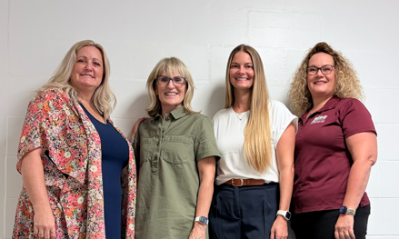
SAHS School Counseling Department
Who is my Counselor
****Counselors will be at all three lunches****
    Last Names A-F & Dual Enrollment : Mrs. Esguerra
    Last Names G-O: Mrs. Barber
    Last Names P-Z: Ms. Nickerson
    AICE Program: Mrs. Eakins

Slide 3
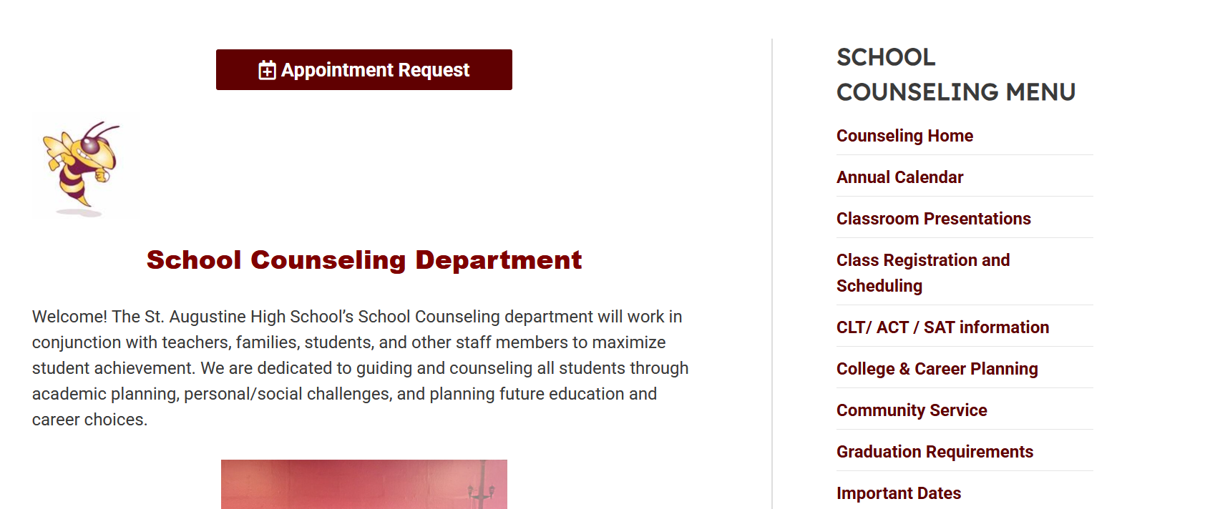
School Counseling Appointments and Information
Check the SAHS Website and Schoology Group
School Counselor Website
https://www-sahs.stjohns.k12.fl.us/guidance/
Schoology Group:
Yellow Jackets School Counseling Group
School Counselor Connect Form
QR code in Lunchroom, Guidance and your classrooms

Slide 4
Graduation Requirements
3 basic requirements:
    Pass 2 state assessments (tests)
    Earn 24 Credits
    Earn a 2.0 GPA

Slide 5
Assessments
MUST pass these two assessments to earn a High School Diploma
  Algebra 1 EOC (level 3 or above) or
    ACT Math – 16 or
    SAT Math – 420 or
    CLT QR Section-14 or
    PSAT/NMSQT Math – 430 or
    Geometry – Level 3
  Grade 10 FAST (level 3 or above) or
    ACT Reading and English average – 18 or
    SAT Evidence-Based Reading and Writing – 490 or
    CLT – 39 or
    PSAT/NMSQT – 470

Slide 6
Credits
24 credits must be earned in all of the following:
  English 1, 2, 3, and 4
  Algebra, Geometry, and two additional math courses
  Biology and two additional sciences
  World History, US History, Government, and Economics
  Practical/performing/fine arts
  HOPE
  7.5 elective credits & .5 credit in Personal Financial Literacy (not required for class of 2026)
    If you’re planning to attend college, you will need two credits in the SAME world language

Slide 7
GPA
Required GPA = 2.0 cumulative unweighted or higher
  2.0 is a “C” average
  Check HAC regularly to keep track of grades

Slide 8
ACT and SAT
ACT, CLT and SAT are college entrance exams.
Ideal time to take these is Spring of 11th grade and again in Fall of 12th grade (after finishing Algebra 2).
Register online and pay attention to deadlines!
Fee waivers available for F/RL from Mrs, Watson (in the Media Center)
Notes:
Remind students that ACT/SAT scores can meet the FSA Reading graduation requirement.

Slide 9
Financial Aid and Scholarships
Seniors should submit their Bright Futures online applications (FFAA) starting October 1st.
https://www.floridastudentfinancialaidsg.org/SAPHome/SAPHome?url=home – Bright Futures
FAFSA now opens on October 1st
https://studentaid.gov/h/apply-for-aid/fafsa - FAFSA
Scholarship page
Schoology: Class of 2027-> Resources-> Scholarships

Slide 10

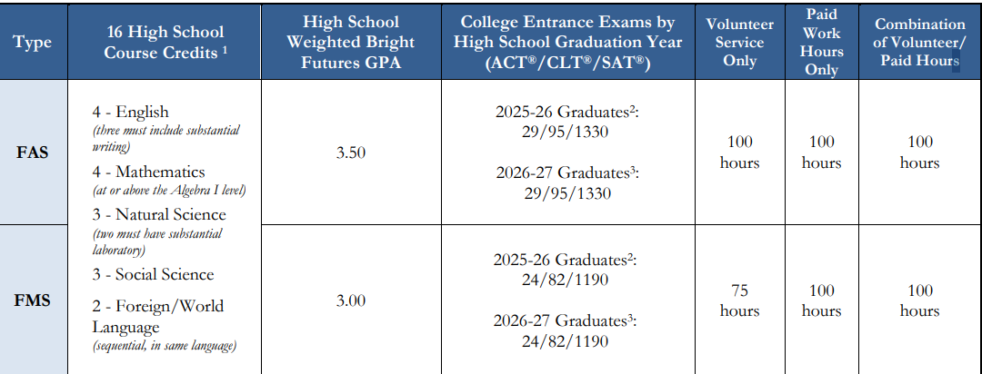
Bright Futures 2026-2027 Criteria
ACT : 29 or 24
SAT: 1330 or 1190
CLT: 82 or 95

Slide 11

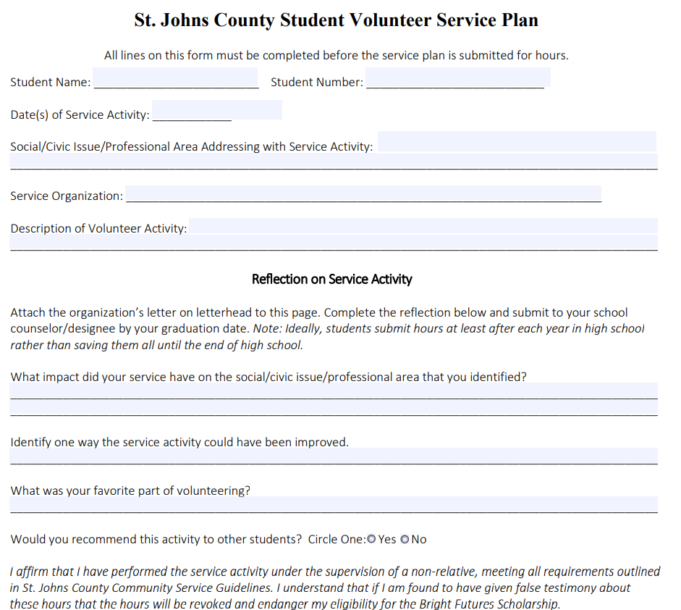
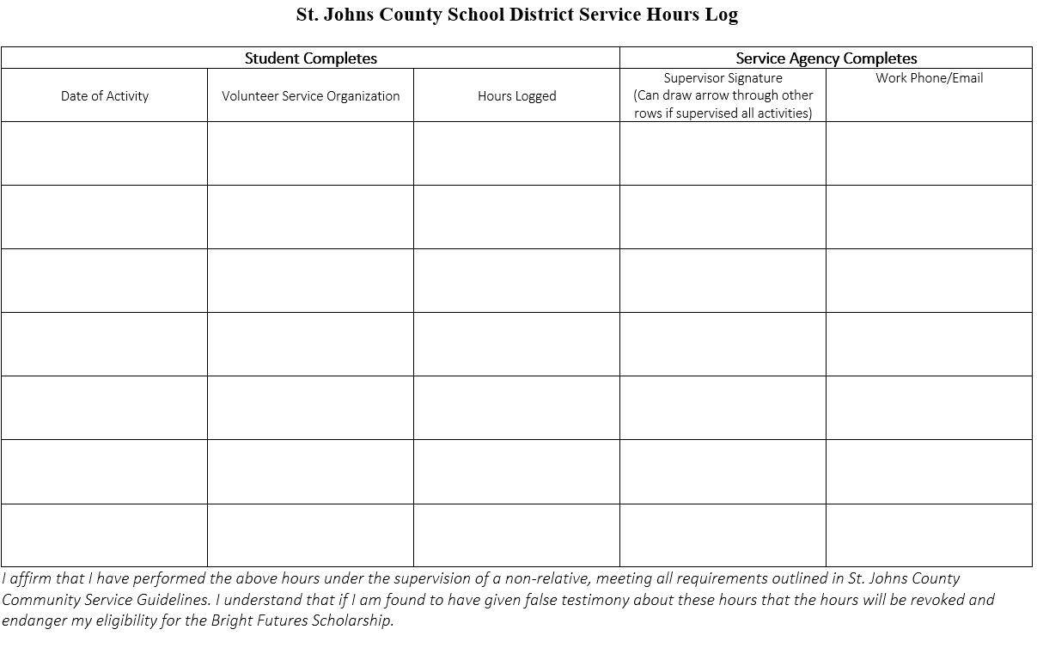
Community Service Forms
Pick up in School Counseling Office

Slide 12
Community Service
Not needed for graduation
Needed for Bright Futures
Forms turned into your counselor
Goal should be to complete 100 hours
Two forms required for all activities:
  Service Plan
  Service Log
Signed letter on the organization’s letterhead required for any activities outside of the school describing type of service, who in the community the service benefited and a description of the service event.

Slide 13
College Applications
Many applications are due in the fall (November 1). Go online to look at deadlines. Apply early! Apply to college with Common App
Order your transcripts by submitting a request online through www.Parchment.com. There is a link on the SAHS website.
Order official SAT/ACT score reports online to be sent directly to colleges.
No four-year Fl state college require a letter of recommendation.
Fee waivers available for FR/RL.

Slide 14
College Visits at SAHS
Colleges and University representatives will be visiting the SAHS campus throughout the year.
Pay attention to Schoology and morning announcements.
College representatives will be visiting during your lunches.

Slide 15
SJR State Dual Enrollment
What is it?
  Traditional Dual enrollment is a Florida educational program that enables high school students to take a college course and be awarded both college credits and the high school credit for the single course.
St Johns River State College (SJRSC) Advising
  High school counselors cannot advise on AA degree requirements or pre-requisites needed for intended majors. Students should contact the SJRSC advising office if students need help determining which college classes that should be taken to fulfill AA degree requirements or pre-requisite requirements.
  For general questions or to make an appointment call 904-808-7402

Slide 16
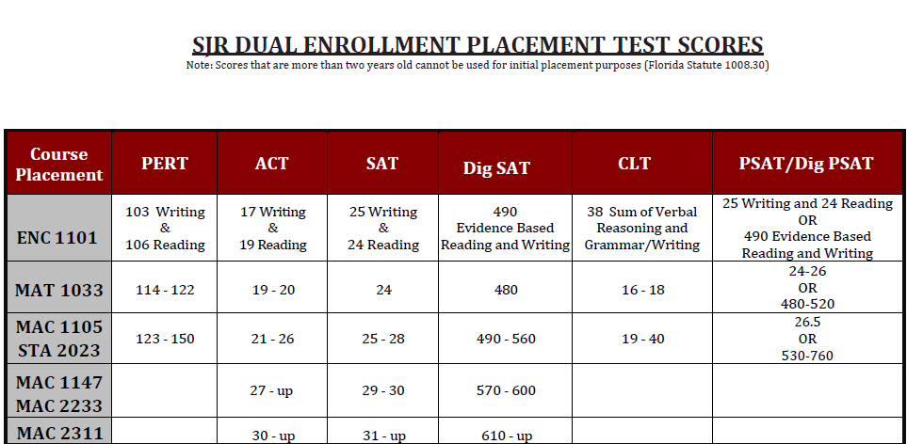
SJR Dual Enrollment – What do you need?
3.0 unweighted, cumulative GPA and
Submit a complete and accurate dual enrollment application, registration/approval form, and proof of qualifying placement scores, by the SAHS published deadline
  Students will be informed when dual enrollment applications and registration/approval forms are available as well as deadlines using the following: SJR Schoology Group, and the dual enrollment website

Slide 17
Not applying to a university?
State colleges (SRJ, FSJC) require a diploma and college ready test scores on ACT/SAT/CPT
Thinking military? Start talking to a recruiter now.
Research technical schools and their criteria.
  FCTC has a lot of great career programs!
Check out Xello on Clever for students.

Slide 18
FCTC Programs
Air Conditioning & Refrigeration
Landscape & Turf Management
Nursery Management
Automotive Service Technology
Culinary Arts
Diesel Technologies
Dental Assisting
Medical Assisting
Welding Technologies
Agriscience
  Horticulture Science and Service
Cosmetology
  Facials Specialty
  Nails Specialty
Early Childhood Education

Slide 19




United States Armed Forces
United States Marine Corps –
First on the ground, takes position.
United States Army –
Holds and fortifies position.
United States Navy –
Supports from sea.
United States Air Force –
Supports from air.

Slide 20

United States Armed Forces Benefits
Completing 3 years of honorable service will pay for your college.
Very competitive pay and benefits.
Healthcare and Travel.

Slide 21
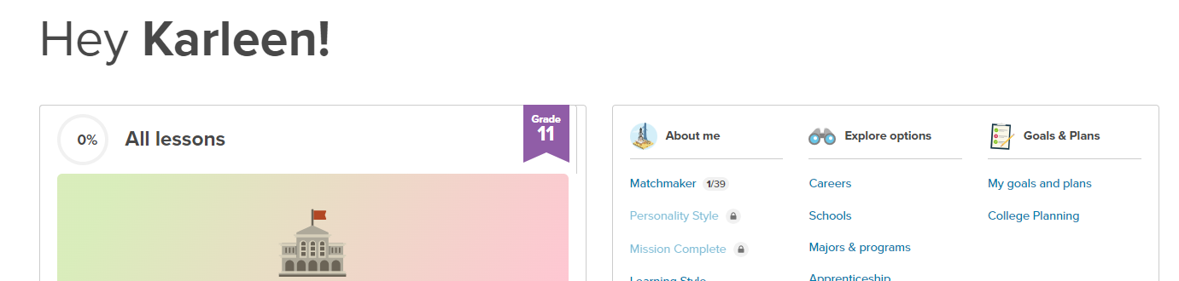
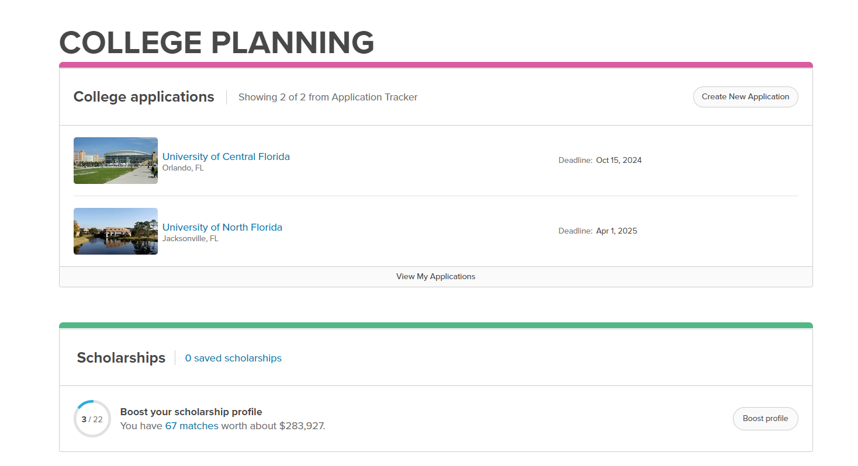

Xello
Log into Clever (look for icon above)
Find College Planning
Add Colleges you wish to apply for
Will have you link to Common App

