Slide 1
10th Grade –
One Year Completed Toward Graduation, What to Consider for Year Two!
Class of 2028

Slide 2
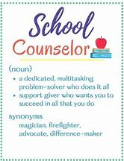
SAHS School Counseling Department
Who is my Counselor
    Last Names A-F: Ms. Patterson
    Last Names G-O: Mrs. Barber
    Last Names P-Z: Ms. Nickerson
    AICE Program: Mrs. Eakins
****Counselors will be in all three lunches****

Slide 3
Requirements for Standard 24 Credit Diploma
Assessments (Math and English ELA)
2.0 Cumulative, Unweighted GPA
24 specific credits

Slide 4
TWO ASSESSMENTS
  MUST pass these two assessments to earn a High School diploma
  Algebra 1 EOC (level 3 or above) or
    ACT Math – 16 or
    SAT Math – 420 or
    CLT - 14
    PSAT/NMSQT Math – 430 or
    Geometry – Level 3
  Grade 10 FAST (level 3 or above) or
    ACT Reading and English average – 18 or
    SAT Evidence-Based Reading and Writing – 490
    CLT – 39
    PSAT/NMSQT Reading & Writing - 470
    If you earn a Certificate of Completion that means you did not pass one or both of these assessments and you do not receive a high school diploma.

Slide 5
Credits
24 credits must be earned in all of the following:
  English 1, 2, 3, and 4
  Algebra, Geometry, and two additional math courses
  Biology and two additional sciences
  World History, US History, Government, and Economics
  Practical/performing/fine arts
  HOPE
  7.5 elective credits and .5 credit in Personal Financial Literacy
    If you’re planning to attend college, you will need two credits in the SAME world language

Slide 6
Promotion Requirements for SJCSD
9th to 10th Grade
  5 credits
10th to 11th Grade
  11 credits
11th to 12th Grade
  17 credits

Slide 7
What do colleges look for?
Well rounded student
GPA (grade point average)
Test scores (ACT and SAT)
Community service hours
Rigorous courses taken (Dual Enrollment, AICE, AP, Honors)
Extra-curricular and leadership activities – Quality, not Quantity

Slide 8

What is Bright Futures?
A scholarship program that can help pay for you to go to college!
Check out the Bright Futures chart with the criteria.
Start working hard now for a big payoff $$$.
Notes:
Go to Tab 4 in packet.

Slide 9

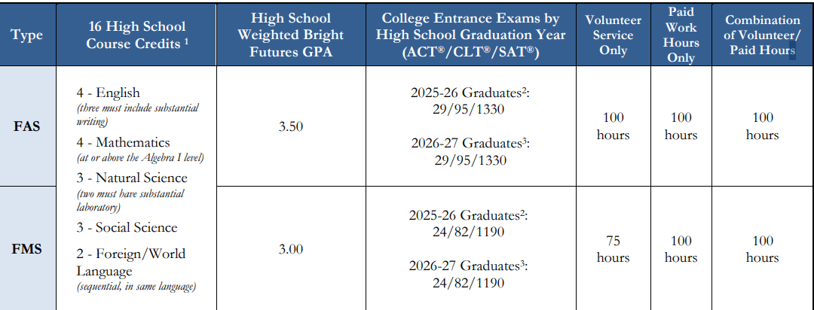
Bright Futures 2025-2026 Criteria
ACT : 29 or 24
SAT: 1330 or 1190
CLT: 82 or 95

Slide 10
Volunteer Hours/Paid Work Hours for Bright Futures
Not needed for graduation
Needed for Bright Futures
Forms turned into your counselor
Goal should be to complete 100 hours of volunteer or paid work hours
Two forms required for all activities:
  Service Plan
  Service Log
Signed letter on the organization’s letterhead required for any activities outside of the school describing type of service, who in the community the service benefited and a description of the service event.

Slide 11
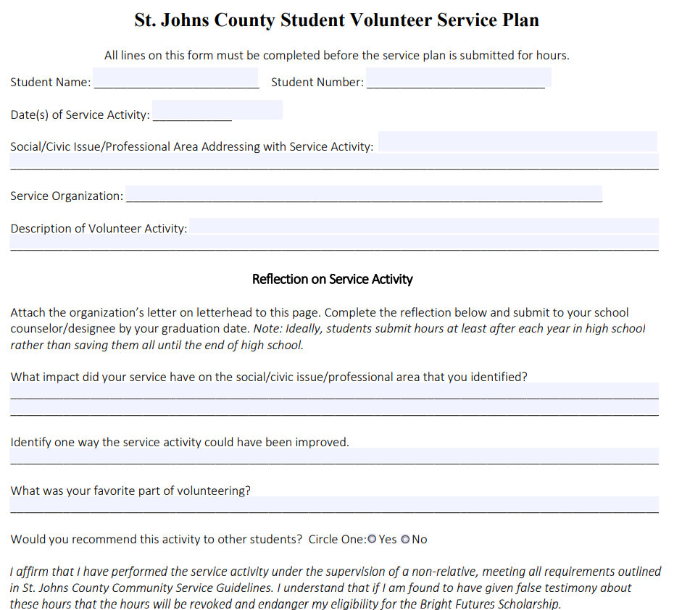
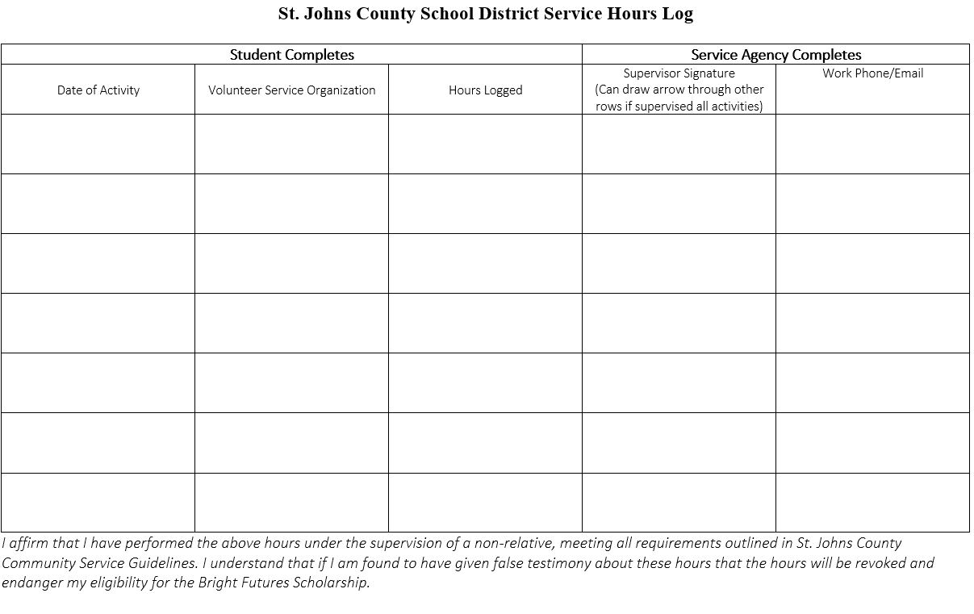
Community Service Forms
Pick up in School Counseling Office

Slide 12




Review of the
PSAT/NMSQT
Test length: 2 hours 14 minutes
No points deducted for incorrect answers or unanswered questions, also known as “rights-only scoring”
Personalized SAT practice through
Khan Academy® with students' own
PSAT/NMSQT scores
Scale ranges for the scores are
320 – 1520 for the total score
Test Date: Wed., October 22nd
PSAT can help you qualify you for scholarships and other honors as well as a concordant score for the Algebra 1 EOC. It can also help you start thinking about and planning for college, see which academic skills you need to work on, and get ready for the SAT.

Slide 13
SJR State Dual Enrollment
What is it?
  Traditional Dual enrollment is a Florida educational program that enables high school students to take a college course and be awarded both college credits and the high school credit for the single course.
St Johns River State College (SJRSC) Advising
  High school counselors cannot advise on AA degree requirements or pre-requisites needed for intended majors. Students should contact the SJRSC advising office if students need help determining which college classes that should be taken to fulfill AA degree requirements or pre-requisite requirements.
  For general questions or to make an appointment call 904-808-7402

Slide 14
SJR Dual Enrollment – What do you need?
College Ready Placement Scores (see next page) and
3.0 unweighted, cumulative GPA and
A Dual Enrollment application and
A Registration Form for your classes

Slide 15
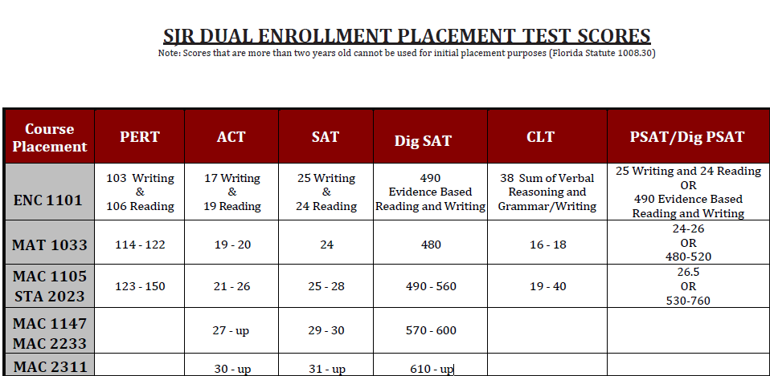
Testing for SJR State Dual Enrollment

Slide 16
FCTC Dual Enrollment Programs
Air Conditioning & Refrigeration
Landscape & Turf Management
Nursery Management
Automotive Service Technology
Culinary Arts
Diesel Technologies
Dental Assisting
Medical Assisting
Welding Technologies

Slide 17
FCTC DE Minimum Requirements
Good attendance and discipline record
2.0 unweighted GPA
On track for graduation
Room in schedule for a minimum of two consecutive periods.

Slide 18
FCTC High School Elective Programs
Agriscience
  Horticulture Science and Service
Culinary Arts
Cosmetology
  Facials Specialty
  Nails Specialty
Early Childhood Education
*Room in schedule for a minimum of two consecutive periods.

Slide 19

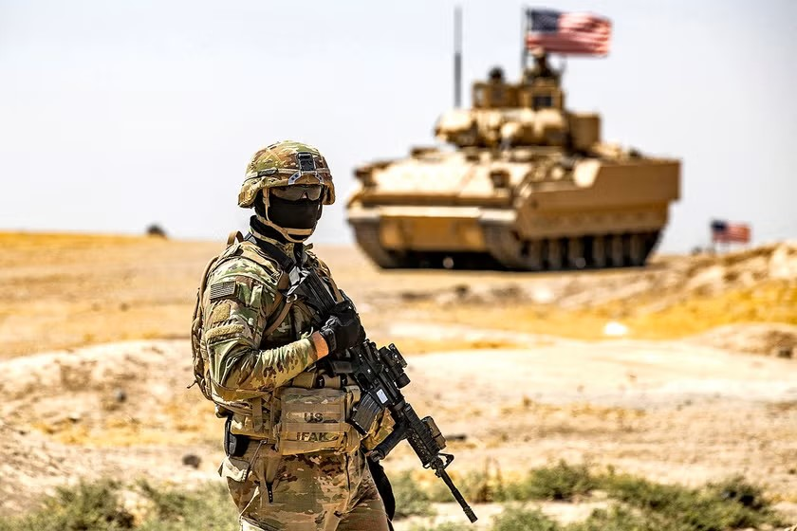
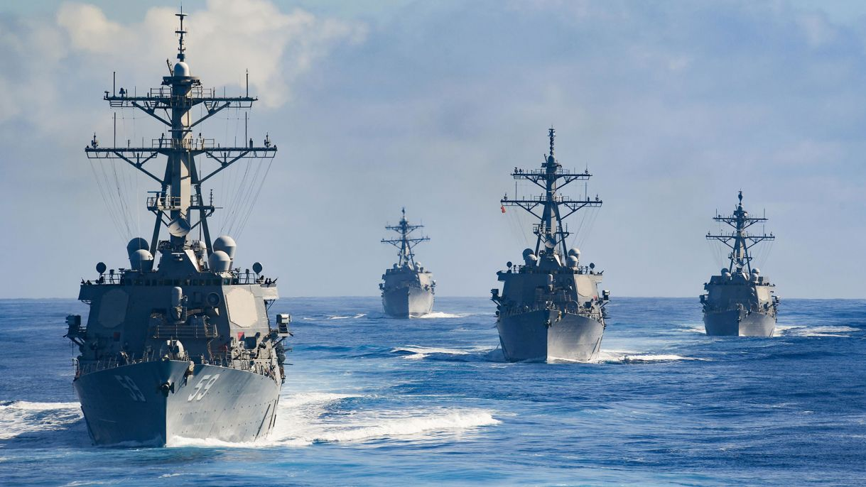
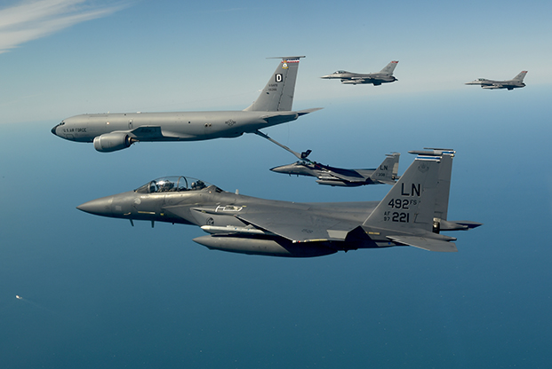
United States Armed Forces
United States Marine Corps –
First on the ground, takes position.
United States Army –
Holds and fortifies position.
United States Navy –
Supports from sea.
United States Air Force –
Supports from air.

Slide 20

United States Armed Forces Benefits
Completing 3 years of honorable service will pay for your college.
Very competitive pay and benefits.
Healthcare and Travel.

