Slide 1
Class of 2029
What you need to know Freshman Year!

Slide 2

SAHS School Counseling Department
Who is my Counselor
    Last Names A-F: Mrs. Patterson
    Last Names G-O: Mrs. Barber
    Last Names P-Z: Ms. Nickerson
    AICE Program: Mrs. Eakins
****Counselors will be at all three lunches****

Slide 3
How can my counselor help me?
We work together with students, families, teachers and other school staff to help you achieve.
We assist with:
          Academic planning
          Personal/social challenges
          Planning future education and career choices
Students may request an appointment with their counselor online. We will either respond to you via Schoology/Email or a pass will be sent for you on the day of the appointment.

Slide 4
Graduation Requirements
3 basic requirements:
    Pass 2 state assessments (tests)
    Earn 24 Credits
    Earn a 2.0 GPA

Slide 5
Assessments
MUST pass these two assessments to earn a High School Diploma
  Algebra 1 EOC (level 3 or above) or
    ACT Math – 16 or
    SAT Math – 420 or
    CLT QR Section-14 or
    PSAT/NMSQT Math – 430 or
    Geometry – Level 3
  Grade 10 FAST (level 3 or above) or
    ACT Reading and English average – 18 or
    SAT Evidence-Based Reading and Writing – 490 or
    CLT – 39 or
    PSAT/NMSQT – 470
If you earn a Certificate of Completion that means you did not graduate from high school and your post-secondary options are limited.

Slide 6
Credits
24 credits must be earned in all of the following:
  English 1, 2, 3, and 4
  Algebra, Geometry, and two additional math courses
  Biology and two additional sciences
  World History, US History, Government, and Economics
  Practical/performing/fine arts
  HOPE
  7.5 elective credits and .5 credit in Personal Financial Literacy
    If you’re planning to attend college, you will need two credits in the SAME world language

Slide 7
Promotion Requirements for SJCSD Students
9th → 10th Grade = 5 credits
10th → 11th Grade = 11 credits
11th → 12th Grade = 17 credits

Slide 8
GPA
Required GPA = 2.0 cumulative unweighted or higher
  2.0 is a “C” average
  Check HAC regularly to keep track of grades

Slide 9
How do we calculate GPA?
Add the “grade points” you have earned, and divide by the number of grades.
A = 4
B = 3
C = 2
D = 1
F = 0
Notes:
Ask students how they would find the average age of everyone in the room. Relate GPA to the same averaging concept – add up all the grade points and divide by the number of classes.

Slide 10
Let’s try an example…
Joe’s 1st semester grades:
  Earth/Space Science D
  Algebra 1 C
  English 1 D
  HOPE C
  Peer Counseling B
  Digital Art B
  Weight Training D
What is Joe’s 1st semester GPA?
Notes:
Tell students to take out scratch sheet of paper. Ask them what they think of Joe’s report card – how’s he doing? Is he passing? Work through the example out loud with them. 1.83 is not high enough for graduation!

Slide 11
Let’s try an example…
Joe’s 1st semester grades:
  Earth/Space Science D
  Algebra 1 C
  English 1 D
  HOPE C
  Peer Counseling B
  Digital Art B
  Weight Training D
1 + 2 + 1 + 2 + 3 + 3 + 1 = 13
13/7 = 1.86
Notes:
Tell students to take out scratch sheet of paper. Ask them what they think of Joe’s report card – how’s he doing? Is he passing? Work through the example out loud with them. 1.83 is not high enough for graduation!

Slide 12
Let’s try another…
Joe’s 2nd semester grades:
  Earth/Space Science D C
  Algebra 1 C A
  English 1 D C
  HOPE C B
  Peer Counseling B A
  Digital Art B A
  Weight Training D B
What is Joe’s 2nd semester GPA?
Notes:
2nd semester, he focuses and brings up his grades a bit. What happens to his GPA? We use ALL grades (cumulative) and divide by 14.

Slide 13
Let’s try another…
What is Joe’s cumulative GPA for 9th grade?
Joe’s 2nd semester grades:
  Earth/Space Science D C
  Algebra 1 C A
  English 1 D C
  HOPE C B
  Peer Counseling B A
  Digital Art B A
  Weight Training D B
1 + 2 + 1 + 2 + 3 + 3 + 1 + 2 + 4 + 2 + 3 + 4 + 4 + 3 = 35
35/14 = 2.5
Notes:
2nd semester, he focuses and brings up his grades a bit. What happens to his GPA? We use ALL grades (cumulative) and divide by 14.

Slide 14
What about “advanced” classes?
For Honors/Pre-AICE level classes, add .5 points.
  A = 4.5, B = 3.5, C = 2.5, D = 1.5, F = 0
For AICE/AP/Dual Enrollment classes, add 1
  A = 5, B = 4, C = 3, D = 2, F = 0
Notes:
Explain weighting. It pays to take challenging courses.

Slide 15
Now, calculate your GPA using your Q1 grades
Is it where you want it to be?
Notes:
Students can access HAC on phones to check current grades and calculate. If they don’t know their HAC access- today is the day to find out! Their teacher can access it for them. Give only a few minutes for this activity.

Slide 16
Why aren’t D’s really Passing?
They may earn you credit for the course, but they won’t get you to a 2.0 GPA!

Slide 17
What if I’m struggling?
Track your assignments on HAC.
Communicate with your teachers.
Take advantage of retake opportunities.
Meet with your teacher for extra help before school.
Leaning Lunch is offered during your LUNCH.
Student tutors are available; ask your counselor for more information.
Use online resources like www.khanacademy.org, and Algebra Nation.
Make an appointment with your counselor.
Notes:
Go to Tab 3 in the info packet. Talk through steps.

Slide 18
What do I need to do as a freshman?
Realize that every day, every class matters!
Participate in class, do your homework, try your best.
Get organized; practice good study habits
Don’t be “too cool” to be smart.
Get to know your teachers, counselor, and make connections.
Start thinking about what you want to do after graduation. This will help drive your “path” through high school – which classes to take, which activities to join, etc.
Get involved at school! Join clubs, sports, community service, social events, etc.

Slide 19
What do colleges look for?
Well rounded student
GPA (grade point average)
Test scores (ACT, CLT and SAT)
Community service hours
Rigorous courses taken (Dual Enrollment, AICE, AP, Honors)
Extra-curricular and leadership activities – Quality, not Quantity

Slide 20

What is Bright Futures?
(look at chart)
A scholarship program that can help pay for you to go to college!
Check out the Bright Futures chart with the criteria.
Start working hard now for a big payoff $$$.
Notes:
Go to Tab 4 in packet.

Slide 21

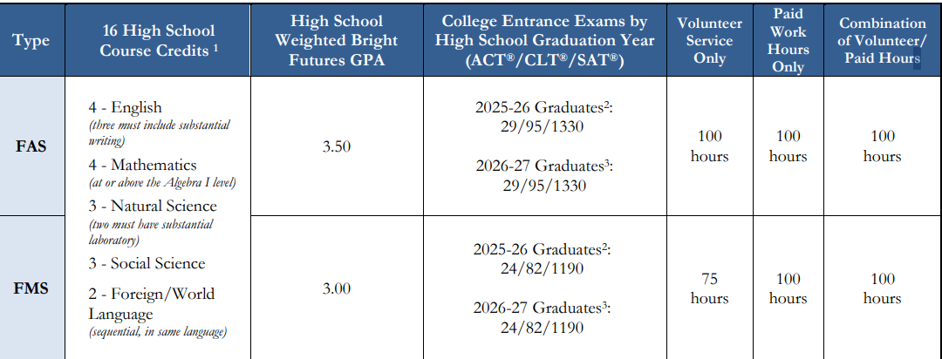
Bright Futures 2025-2026 Criteria
ACT : 29 or 24
SAT: 1330 or 1190
CLT: 82 or 95

Slide 22
100 Hour of Volunteer or Paid Work Hours
Not needed for graduation
Needed for Bright Futures
Forms turned into your counselor
Goal should be to complete 100 hours of community service and work combined
Two forms required for all activities:
Service Plan
Service Log
Signed letter on the organization’s letterhead required for any activities outside of the school describing type of service, who in the community the service benefited and a description of the service event.

Slide 23
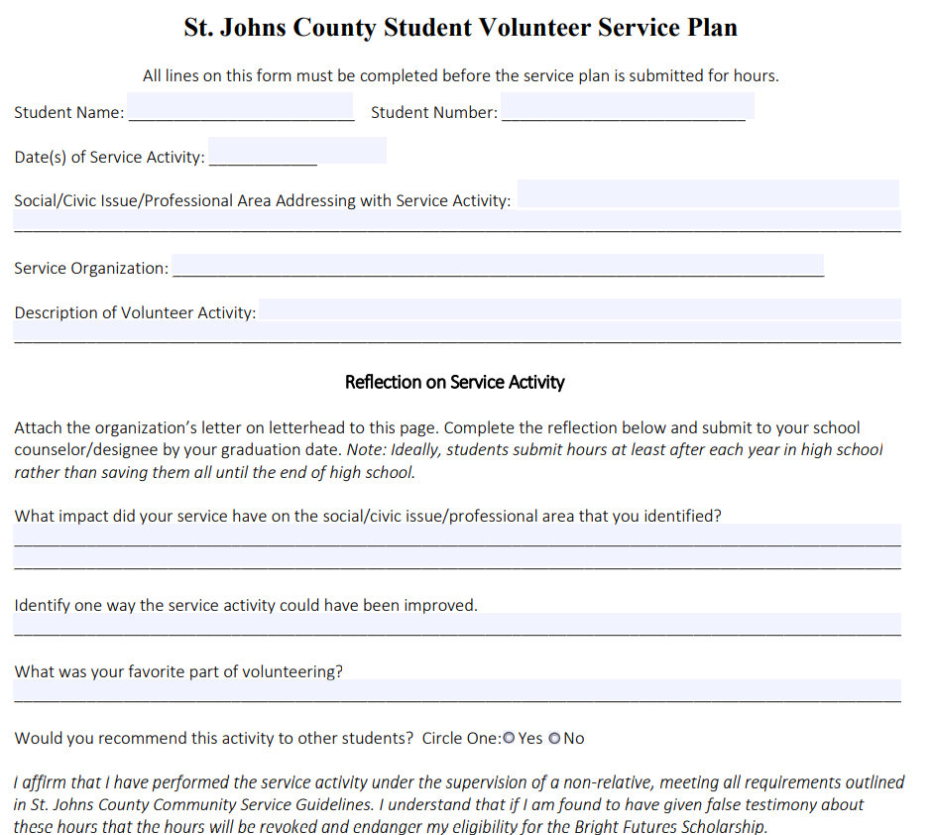
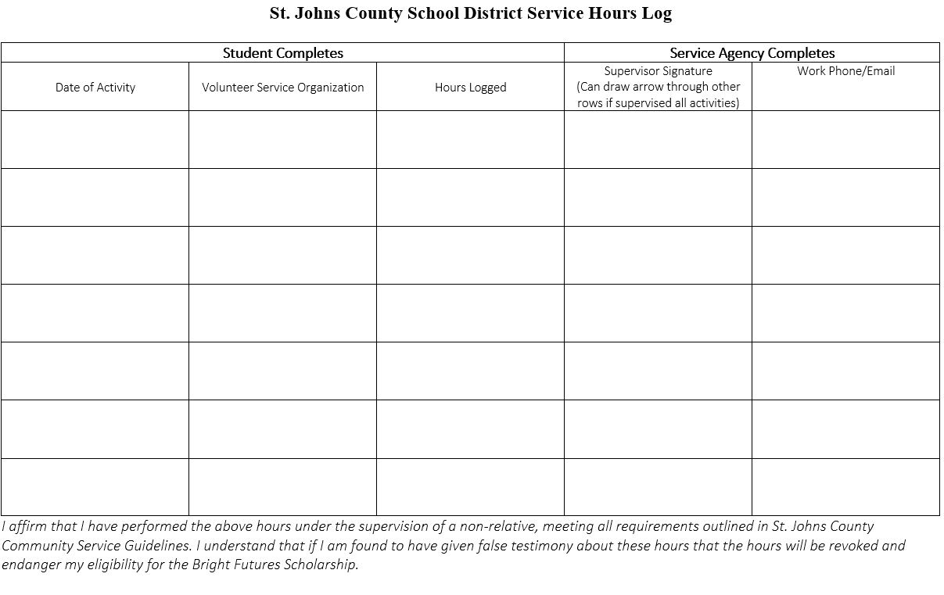
Community Service Forms
Pick up in School Counseling Office

