Slide 1
Class of 2025 & 2026 What you need to know

Slide 2
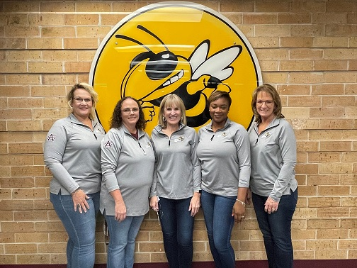
SAHS School Counseling Department
Who is my Counselor
Last Names A-G: Mrs. Cashwell
Last Names H-P: Mrs. Barber
Last Names Q-Z: Mrs. Rollins
AICE Program: Mrs. Bechtle
College/Career: Mrs. Eakins
****Open door policy during your lunch****

Slide 3
How can my counselor help me?
We work together with students, families, teachers and other school staff to help you achieve.
We assist with:
Academic planning
Personal/social challenges
Planning future education and career choices
Students may request an appointment with their counselor online. A pass will be sent for you on the day of the appointment.

Slide 4
Graduation Requirements
3 basic requirements:
Earn 24 Credits
Earn a 2.0 GPA
Pass 2 state assessments (tests)

Slide 5
Assessments
MUST pass these two assessments to earn a diploma
State Math Assessment
State Reading/Writing Assessment
If you earn a Certificate of Completion that means you did not graduate from high school and your post-secondary options are limited

Slide 6
Credits
24 credits must be earned in all of the following:
English 1, 2, 3, and 4
Algebra, Geometry, and two additional math courses
Biology and two additional sciences
World History, US History, Government, and Economics
Practical/performing/fine arts
HOPE
8 elective credits
If you’re planning to attend college, you will need two credits in the SAME world language

Slide 7
Credits

Slide 8
Promotion Requirements
9th → 10th Grade = 5 credits
10th → 11th Grade = 11 credits
11th → 12th Grade = 17 credits

Slide 9
GPA and Online Credit
Required GPA = 2.0 cumulative unweighted or higher
2.0 is a “C” average
Check HAC regularly to keep track of grades
Must complete one full length online course
Right now at SAHS, the required Government course will count for the online course

Slide 10
How do we calculate GPA?
Add the “grade points” you have earned, and divide by the number of grades.
A = 4
B = 3
C = 2
D = 1
F = 0
Notes:
Ask students how they would find the average age of everyone in the room. Relate GPA to the same averaging concept – add up all the grade points and divide by the number of classes.

Slide 11
Let’s try an example…
Joe’s 1st semester grades:
Earth/Space Science D
Algebra 1 C
English 1 D
HOPE C
Peer Counseling B
Digital Art B
Weight Training D
What is Joe’s 1st semester GPA?
Notes:
Tell students to take out scratch sheet of paper. Ask them what they think of Joe’s report card – how’s he doing? Is he passing? Work through the example out loud with them. 1.83 is not high enough for graduation!

Slide 12
Let’s try an example…
Joe’s 1st semester grades:
Earth/Space Science D
Algebra 1 C
English 1 D
HOPE C
Peer Counseling B
Digital Art B
Weight Training D
1 + 2 + 1 + 2 + 3 + 3 + 1 = 13
13/7 = 1.86
Notes:
Tell students to take out scratch sheet of paper. Ask them what they think of Joe’s report card – how’s he doing? Is he passing? Work through the example out loud with them. 1.83 is not high enough for graduation!

Slide 13
Let’s try another…
Joe’s 2nd semester grades:
Earth/Space Science D C
Algebra 1 C A
English 1 D C
HOPE C B
Peer Counseling B A
Digital Art B A
Weight Training D B
What is Joe’s 2nd semester GPA?
Notes:
2nd semester, he focuses and brings up his grades a bit. What happens to his GPA? We use ALL grades (cumulative) and divide by 14.

Slide 14
Let’s try another…
What is Joe’s cumulative GPA for 9th grade?
Joe’s 2nd semester grades:
Earth/Space Science D C
Algebra 1 C A
English 1 D C
HOPE C B
Peer Counseling B A
Digital Art B A
Weight Training D B
1 + 2 + 1 + 2 + 3 + 3 + 1 + 2 + 4 + 2 + 3 + 4 + 4 + 3 = 35
35/14 = 2.5
Notes:
2nd semester, he focuses and brings up his grades a bit. What happens to his GPA? We use ALL grades (cumulative) and divide by 14.

Slide 15
What about “advanced” classes?
For Honors/Pre-AICE level classes, add .5 points.
A = 4.5, B = 3.5, C = 2.5, D = 1.5, F = 0
For AICE/AP/Dual Enrollment classes, add 1
A = 5, B = 4, C = 3, D = 2, F = 0
Notes:
Explain weighting. It pays to take challenging courses.

Slide 16
Now, calculate your GPA using your Q1 grades
Is it where you want it to be?
Notes:
Students can access HAC on phones to check current grades and calculate. If they don’t know their HAC access- today is the day to find out! Their teacher can access it for them. Give only a few minutes for this activity.

Slide 17
Why aren’t D’s really Passing?
They may earn you credit for the course, but they won’t get you to a 2.0 GPA!

Slide 18
What if I’m struggling?
Track your assignments on HAC.
Communicate with your teachers.
Take advantage of retake opportunities.
Meet with your teacher for extra help before school.
Student tutors are available; ask your counselor for more information.
Use online resources like www.khanacademy.org, and Algebra Nation.
Make an appointment with your counselor.
Notes:
Go to Tab 3 in the info packet. Talk through steps.

Slide 19
It’s not too soon to be thinking about your post-secondary plans!
Look at the checklist of what you should be doing each year of high school to get ready for college.
The SUS (State University System) chart shows you information for universities in Florida.
Notes:
Back to Tab 3 – see Year by Year checklist.

Slide 20
What do colleges look for?
Well rounded student
GPA (grade point average)
Test scores (ACT and SAT)
Community service hours
Rigorous courses taken (Dual Enrollment, AICE, AP, Honors)
Extra-curricular and leadership activities – Quality, not Quantity

Slide 21
Review of the PSAT/NMSQT
Test length: 2 hours 45 minutes
No points deducted for incorrect answers or unanswered questions, also known as “rights-only scoring”
Personalized SAT practice through Khan Academy® with students' own PSAT/NMSQT scores
Scale ranges for the scores are 320 – 1520 for the total score
Test Date: Wed., October 12
PSAT can help you qualify you for scholarships and other honors as well as a concordant score for the Algebra 1 EOC. It can also help you start thinking about and planning for college, see which academic skills you need to work on, and get ready for the SAT.

Slide 22
What is Bright Futures? (look at chart)
A scholarship program that can help pay for you to go to college!
Check out the Bright Futures chart with the criteria.
Start working hard now for a big payoff $$$.
Notes:
Go to Tab 4 in packet.

Slide 23
Volunteer Hours/Paid Work Hours for Bright Futures
Not needed for graduation
Needed for Bright Futures
Forms turned into your counselor
Goal should be to complete 100 hours
Two forms required for all activities:
Service Plan
Service Log
Signed letter on the organization’s letterhead required for any activities outside of the school describing type of service, who in the community the service benefited and a description of the service event.

Slide 24
Community Service Forms Pick up in School Counseling Office

Slide 25
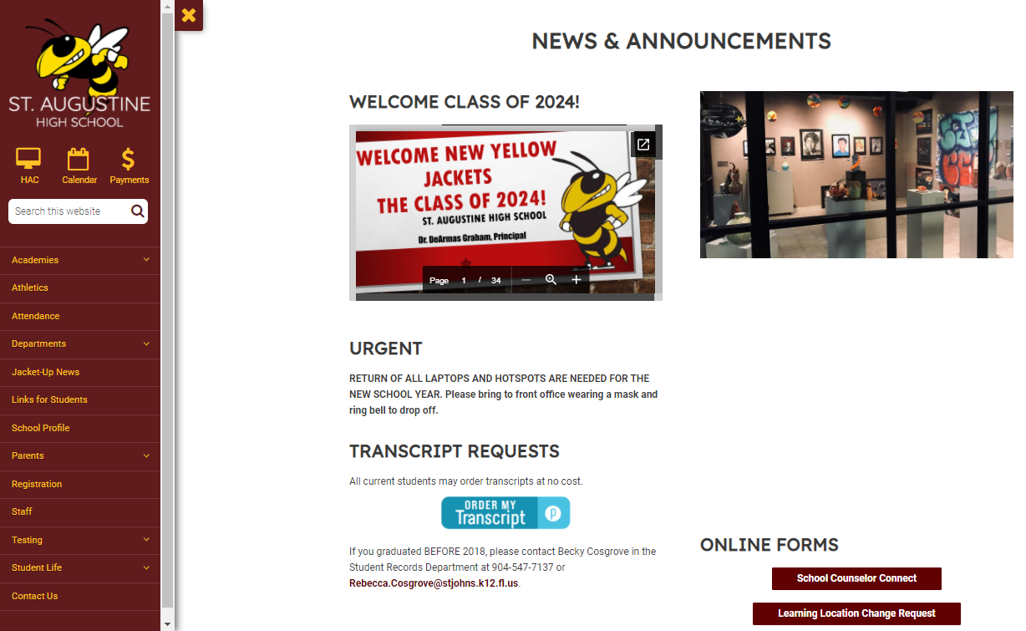
Need to see your school counselor?
Info - School Counseling Website
https://www-sahs.stjohns.k12.fl.us/guidance/
Appointments - School Counselor Connect Form
Schoology - Yellow Jacket School Counseling Group
Instagram - @jacketschoolcounseling

