Slide 1
What you need to know in your Junior/Senior Year!
Classes of 2023 & 2024

Slide 2
CAREER & COLLEGE READINESS SURVEY
https://docs.google.com/forms/d/10FmTa3DCKrcEx1Rp9lnMhBCZ1yigCsnu0azTFSKT-Lw/edit

Slide 3
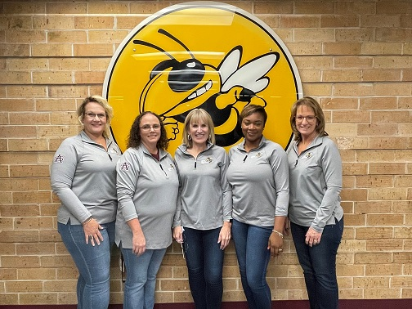
SAHS School Counseling Department
Who is my Counselor
Last Names A-G: Mrs. Cashwell
Last Names H-P: Mrs. Barber
Last Names Q-Z: Ms. Rollins
AICE Program: Mrs. Bechtle
College/Career: Mrs. Eakins
****Open door policy during your lunch****

Slide 4
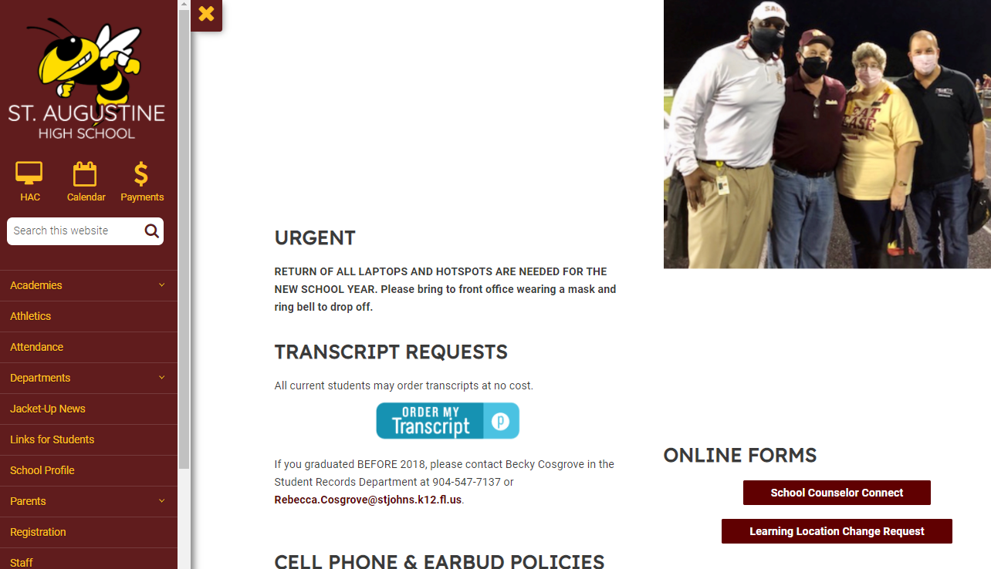
School Counseling Appointments and Information
Check the SAHS Website and Schoology Group
School Counselor Website
https://www-sahs.stjohns.k12.fl.us/guidance/
Schoology Group
Yellow Jackets School Counseling Group
School Counselor Connect Form

Slide 5
PSAT
Test length: 2 hours 45 minutes
No points deducted for incorrect answers or unanswered questions, also known as “rights-only scoring”
Personalized SAT practice through Khan Academy® with students' own PSAT/NMSQT scores
Scale ranges for the scores are 320 – 1520 for the total score
Test Date: Wed., October 12
PSAT can help you qualify you for scholarships and other honors as well as a concordant score for the Algebra 1 EOC. It can also help you start thinking about and planning for college, see which academic skills you need to work on, and get ready for the SAT.

Slide 6
ACT and SAT
ACT and SAT are college entrance exams.
Ideal time to take these is Spring of 11th grade and again in Fall of 12th grade (after finishing Algebra 2).
Register online and pay attention to deadlines!
Fee waivers available for F/RL from Mrs. Eakins (in the HIVE)
Notes:
Remind students that ACT/SAT scores can meet the FSA Reading graduation requirement.

Slide 7
 | SAT | ACT
Total Time | 3 hrs (plus 50 min for optional essay) | 2 hrs 55 min (plus 40 min for optional essay)
Number of sections | 4 plus optional essay | 4 plus optional essay
Sections | Reading: 65 min Writing and Language: 35 min Math (No calculator): 25 min Math (with calculator): 55 min Optional essay: 50 min | English: 45 min Math: 60 min Reading: 35 min Science: 35 min Optional essay: 40 min
Scoring | Two section scores, Evidence-Based Reading and Writing (includes Reading and Writing and Language) and Math, on a 200-800 scale combined for a total score from 400-1600 | Four section scores scaled from 1-36 averaged for a composite from 1-36
Wrong answer penalty? | No | No

Slide 8
Financial Aid and Scholarships
Seniors should submit their FAFSA and Bright Futures online applications (FFAA) starting October 1st.
https://studentaid.gov/h/apply-for-aid/fafsa - FAFSA
https://www.floridastudentfinancialaidsg.org/SAPHome/SAPHome?url=home – Bright Futures
https://www-sahs.stjohns.k12.fl.us/guidance/scholarships/ - Scholarship page on SAHS website

Slide 9
Bright Futures 2021-2022 Criteria

Slide 10
Community Service
Not needed for graduation
Needed for Bright Futures
Forms turned into your counselor
Goal should be to complete 100 hours
Work hours can be submitted for BF
Two forms required for all activities:
Service Plan
Service Log
Signed letter on the organization’s letterhead required for any activities outside of the school describing type of service, who in the community the service benefited and a description of the service event.

Slide 11
Community Service Forms Pick up in School Counseling Office

Slide 12
What do colleges look for?
Well rounded student
GPA (grade point average)
Test scores (ACT and SAT)
Community service hours
Rigorous courses taken (Dual Enrollment, AICE, AP, Honors)
Extra-curricular and leadership activities – Quality, not Quantity

Slide 13
College Applications
Many applications are due in the fall (November 1). Go online to look at deadlines. Apply early!
Order your transcripts by submitting a request online through www.Parchment.com. There is a link on the SAHS website.
Order official SAT/ACT score reports online to be sent directly to colleges.
Work on essays; request letters of recommendation.
Fee waivers available for FR/RL.

Slide 14
College Visits at SAHS
Colleges and University representatives will be visiting the SAHS campus throughout the year.
Pay attention to Schoology and check in the HIVE for dates and locations.
You may sign up in Mrs. Eakins office (the HIVE) to attend the visits.

Slide 15
Not applying to a university?
State colleges (SRJ, FSJC) require a diploma and college ready test scores on ACT/SAT/CPT
Thinking military? Start talking to a recruiter now.
Research technical schools and their criteria.
FCTC has a lot of great career programs!
No idea? Make an appointment with Mrs. Eakins or your counselor so we can help!

Slide 16
SJR State Dual Enrollment
What is it?
Traditional Dual enrollment is a Florida educational program that enables high school students to take a college course and be awarded both college credits and the high school credit for the single course.
St Johns River State College (SJRSC) Advising
High school counselors cannot advise on AA degree requirements or pre-requisites needed for intended majors. Students should contact the SJRSC advising office if students need help determining which college classes that should be taken to fulfill AA degree requirements or pre-requisite requirements.
For general questions or to make an appointment call 904-808-7402

Slide 17
SJR Dual Enrollment – What do you need?
3.0 unweighted, cumulative GPA and
College Ready Math, Reading, and Writing Scores
ACT Reading – 19 or SAT Reading – 24 or CPT Reading – 83 or PERT Reading – 106
ACT English – 17 or SAT Writing and Language – 25 or CPT Sentence Skills – 83 or PERT English – 103
ACT Math – 21 or SAT Math – 25 or CPT Elementary Algebra – 85 or PERT Math - 123
Submit a complete and accurate dual enrollment application, registration/approval form, and proof of qualifying placement scores, by the SAHS published deadline
Students will be informed when dual enrollment applications and registration/approval forms are available as well as deadlines using the following: SJR Schoology Group, and the dual enrollment website

Slide 18
FCTC Programs
Air Conditioning & Refrigeration
Landscape & Turf Management
Nursery Management
Automotive Service Technology
Culinary Arts
Diesel Technologies
Dental Assisting
Medical Assisting
Welding Technologies
Agriscience
Horticulture Science and Service
Culinary Arts
Cosmetology
Facials Specialty
Nails Specialty
Early Childhood Education

