Slide 1
Dual Enrollment Information Session

Slide 2
SJR State Dual Enrollment Office
Meghan Deputy, Director of Dual Enrollment & College Access
Lindsay Hall, Dual Enrollment Specialist (SAHS Contact)
Ivee Sauls, Dual Enrollment Specialist
Marsha Smith, Academic Affairs Office Specialist
Phone: (386) 312-4136
Email: dualenrollment@sjrstate.edu

Slide 3
What is Dual Enrollment?
Dual Enrollment is a acceleration program that allows eligible high school students to earn college credit while simultaneously earning credit toward high school completion.

Slide 4
Dual Enrollment Considerations
Students MUST have a 3.0 unweighted cumulative GPA to qualify for DE. No exceptions!
Dual Enrollment grades begin your college GPA and officially start your college transcript.
Grades can affect your acceptance into other colleges and universities.
Grades can affect your acceptance into limited access majors as well as your admission into graduate school.
Dual Enrollment courses are college level courses. As such, they are rigorous and will not be modified to high school level to accommodate variations in student age and/or maturity.
Notes:
As one of 28 colleges within the Florida College System, SJR State’s student population is typical of that attending most state or “community” colleges nationwide in that the majority of students enrolled are part-time students, the average age of both full and part-time students is mid-twenties, and the overall ratio of male to female students is approximately 60% female, 40% male.

Slide 5
Dual Enrollment Considerations
Dual enrollment students must plan carefully when registering for courses.
Do not overwhelm yourself. Start by taking only 1 DE course in your first semester.
Take into account the rigor and number of high school courses (brick and mortar and virtual school) you are taking with your dual enrollment courses.
All courses require time and effort to be successful.
If you have extracurricular activities or you work, make sure the time required for these activities is taken into account when planning your schedule.
You will NOT be excused from SJR classes due to schedule conflicts with extracurricular activities such as jobs, sports, clubs, dance, theatre, church, vacation, etc.
Determine the number of hours spent at work or on the activity in order to figure out the hours you have available for attending class and for studying.
Please note that the College follows a different calendar than St. Johns County therefore there may be certain days you have off at the high school that you may NOT have off at the College and are expected to attend class.

Slide 6
Dual Enrollment Considerations
If you earn below a C or withdraw (W), you will be removed from the Dual Enrollment program.
Students will want to look at their course syllabus as soon as their classes begin. This will discuss your course assignments, deadlines, and attendance.
Students are expected to handle all communication because they are considered a college student. The College will NOT communicate with parents whatsoever.
Overall, Dual Enrollment is a big undertaking that requires a student to be independent, take ownership of their learning, and practice effective time management.

Slide 7
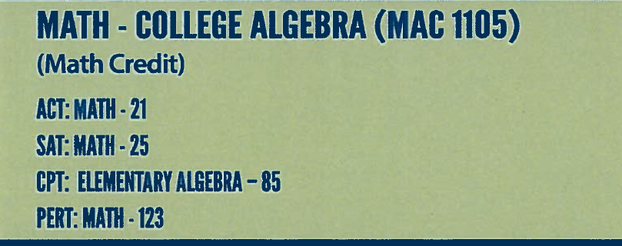

Slide 8
How Do I Get Started?
Application Process
1. Complete the dual enrollment application online
https://bit.ly/2APhdpC (Case sensitive link!)
2. Print and sign consent form at the end of the online application.
3. Submit the signed consent form and a copy of your SAT/ACT/PERT score report to your school counselor. We need a printed score report including the student’s name. We cannot pull scores from the school district database.
Once these steps have been completed and the paperwork processed at SJR, you will be officially enrolled as a Dual Enrollment student at SJR. You will receive a welcome letter and email with MySJRstate login instructions.
Course Registration Process
4. Select your DE course(s) and submit a Course Registration Form to your school counselor. There will be a Course Registration Workshop in May to assist students with this process.
5. Check your MySJRstate account to review your school schedule. It may take a week or so for your classes to appear.

Slide 9
Course Registration
DE students will register for classes each semester as SJR courses run on semester, not year long. There is a fall semester, a spring semester, and a summer semester.
Fall – Middle of August to the second week of December.
Regular dual enrollment – up to 10 credit hours
Early admission students – minimum 12 credit hours and maximum 16 credit hours – no courses at SAHS allowed
Spring – Second week of January to the end of April.
Regular dual enrollment – up to 10 credit hours
Early admission students – minimum 12 credit hours and maximum 16 credit hours – no courses at SAHS allowed
Summer – Three different sessions: 1) begins middle of May to end of June, 2) begins middle of May to middle of August, and 3) begins the first part of July to middle of August.
All dual enrollment students – maximum 2 classes for the summer
Current seniors are not eligible to participate in summer since they will be graduating.

Slide 10
Textbooks
Each semester books are picked up at the Fullerwood Center, Media Services Department located at 10 Hildreth Drive in St. Augustine.
To collect your books, you MUST bring a copy of your printed schedule.
Book pick-up dates: Beginning mid August books will be issued during the weekdays between 8:00am-3:00pm.
Book return dates: books must be returned on due date or you will be charged $10 for every day you are late
For book questions, please call 904-547-3947
All of this information is in the letter as well as on your MySJRstate account.

Slide 11
Parking
If you are going to be driving and parking at the College, you must get a parking decal.
Parking decals are free.
To get a parking decal, you must log-in to your MySJRstate account and under the student tab, you will find the “Request Parking Decal”. After filling this form out, please print it and bring it in to the St. Augustine Campus Security Office for your decal.

Slide 12
Dates/Deadlines
Summer 2020
Online application opens - NOW
Application deadline (consent form and test scores) – April 15, 2020
Registration opens - ?
Registration Form submission deadline – April 15, 2020
If you are planning to register for summer 2020 courses, you will want to schedule an appointment to meet with your school counselor to select courses once the schedule is available.
Fall 2020
Online application opens - Feb. 3, 2020
Application submission deadline – Summer 2020
Registration opens – May 2020
Registration form submission deadline – Summer 2020

Slide 13
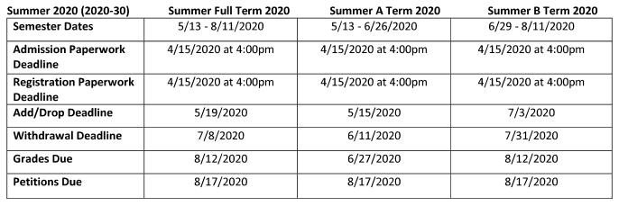
Dates/Deadlines
Make sure you are aware of the College’s calendar dates. It is your responsibility to know when classes begin and end as well as other dates such a drop/add and withdrawal.
http://www.sjrstate.edu/pdfs/2019_2020_DE_Dates_Deadlines.pdf

Slide 14
Add/Drop
Student removes self before drop deadline, which is usually the 1st week.
Course is not on the transcript.
No grade designated.
Not counted as an attempt.
Withdrawal
Student removes self after drop deadline.
Course is listed on the transcript.
Grade of “W” is recorded.
Counted as an attempt.
Submits withdrawal form by the published deadline.
Please find this information by viewing the College’s Academic Calendar. All of this information can be found by logging-in to your student account or by finding it on our webpage.

Slide 15
Registration Issues
Students will register for classes by viewing course availability on our website and completing the appropriate paperwork at the high school.
After selecting courses, please do not assume you are automatically placed in the course. A class that appears to have seats available may be full by the time a student’s registration is processed.
Students must monitor their schedules to make sure they are placed in the appropriate classes.
Any issues will be emailed directly to their SJRState student email account. The student will then work with the high school to correct those issues.
It is the student’s responsibility to know their class schedule.

Slide 16
Student Disability Services
Accommodations can be provided with documentation, and the student will work with the SJR State Disabilities Services to determine what documentation is needed.
If you currently receive accommodations for a disability filed at your high school, please be sure to file it with SJR State College by calling 904-808-7402, Academic Advising on our St. Augustine Campus.
The accommodations process should begin as soon as possible, in order for the student to receive accommodations in a timely manner. It is the student’s responsibility to provide documentation to SJR, not the high school’s.

Slide 17
Importance of Accurate Records
College records are separate from your high school records.
Correcting records takes time and will require additional documentation from you.
Driver’s licenses, social security card, birth certificate
If you request a transcript to be mailed to you, it will be returned to the College as undeliverable if you do not have the correct mailing address on file with SJR State.
If your address is not updated, you will not receive your dual enrollment student schedule each term from the Dual Enrollment Office. In addition, you will not receive the dual enrollment reminder that has important dates and deadlines as well as textbook information.
If you do not have an updated phone number on file, then the College staff will be unable to reach you. The College staff will only be calling you if there is an issue such as a cancelled course, etc.

Slide 18
Resources
https://www-sahs.stjohns.k12.fl.us/guidance/dual-enrollment/
http://sjrstate.edu/
http://www.sjrstate.edu/dual.html

Slide 19
Thank you for your time!
Questions?

