Slide 1
Financial Aid Overview 2022-2023 High School Students 2023-2024 Postsecondary Year
Notes:
Welcome to the financial aid overview presentation. This presentation is specifically for high school students graduating in the 2020-2021 academic year and then enrolling in a post secondary institution for the 2022-2023 academic year.
It is brought to you by the Office of Student Financial Assistance, a division of the Florida Department of Education.
Upon completion of this presentation you will gain a better understanding of the overall financial aid process for all post secondary institutions.
My name is Pedro Hernandez, Outreach Director, here at the Office of Student Financial Assistance. It is my pleasure to guide you through this process.

Slide 2
More than half of all students attending college in the United States receive some form of financial aid.

Slide 3
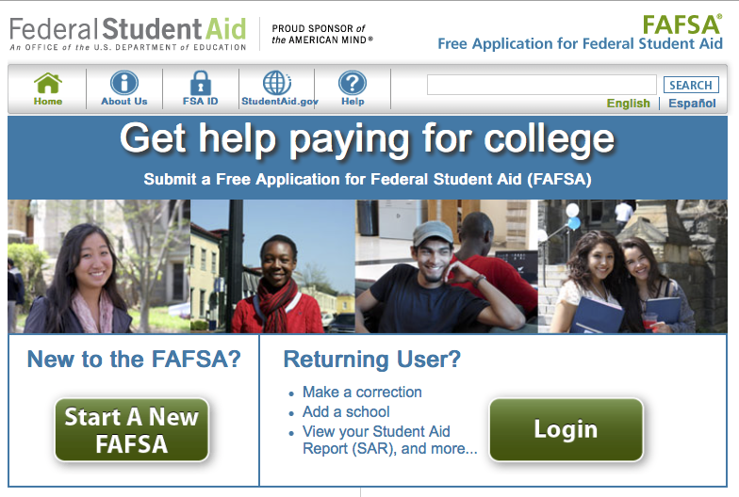
Federal Student Aid
Completing the FAFSA is the first step in securing federal aid for college, career school, or graduate school.
studentaid.ed.gov/sa/fafsa.ed.gov

Slide 4
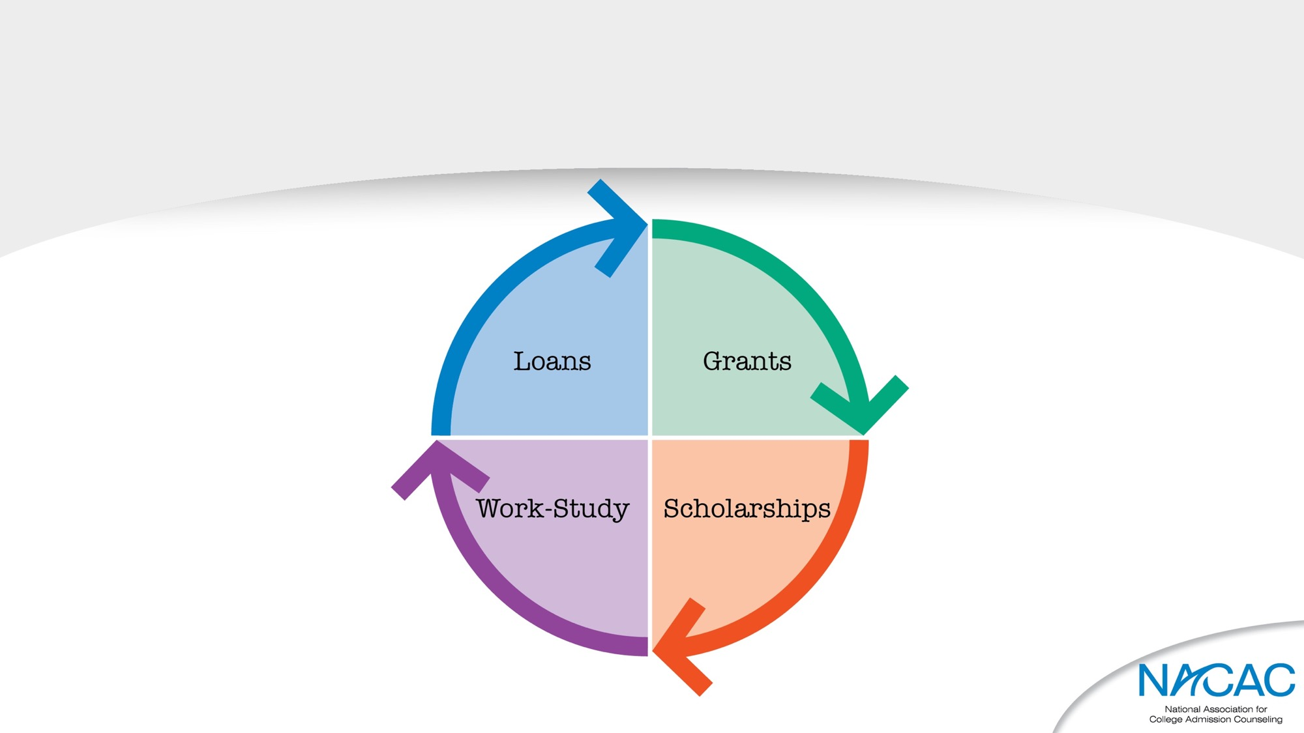
Types of financial aid

Slide 5
What is Financial Aid?
Monies received from Four Sources: Federal, State, Institutional or Private
Monies are also categorized as:
Gift aid
Self-help
Need-based
Merit-based
Can cover direct or indirect costs
Notes:
Let us begin by answering the first question: what is financial aid?
Financial aid is defined as monies received from the (4) major sources federal, state, institutional or private resources.
Federal aid includes funding such as the Pell Grant, Federal student loans, and federal work study.
State financial aid offers a variety of state-funded scholarships and grants that are administered by the FDOE/OSFA and subject to change each year during legislative session.
Institutional aid are monies offered directly from the postsecondary school.
Private resources include a variety of scholarships from various groups such as local employers, national organizations, and community groups.
It is important to research and apply for each of these resources.
Financial Aid May also viewed into the following different categories:
Gift aid – this is free money that DOES NOT require repayment as long as the student meets the parameters outlined for each grant or scholarship. Students should always consult with a financial aid administrator prior to making any schedule changes to determine what repercussions the schedule changes will have on their financial aid awards.
Self help – this can be as easy as taking part of your earnings as applying it toward your college expenses. Students should check with their employer (or potential employers) regarding any tuition assistance or reimbursement programs being offered. Student loans are also considered as a form of “self” help, but should only be used as a last resort.
Need-based – monies awarded based on the applicant’s Free Application for Federal Student Aid (FAFSA). Therefore, it is important to complete your FAFSA as soon as possible. While the Pell Grant is an entitlement program, other need-based monies are awarded on a first-come, first-serve basis.
Merit-based – merit-based monies are available through a variety of avenues that we will discuss throughout today’s presentation. For example, Bright Futures is a merit-based program.
College costs include tuition, fees, and books, along with other expenses such as: transportation, food, housing, clothing and computer costs. Cost of attendance can vary from institution to institution, so check your college’s website for additional information. Financial aid monies can be used toward all items included within the cost of attendance.

Slide 6
Free Application for Federal Student Aid (FAFSA)
Federal government is largest source of student aid; FAFSA distributed and processed by the U.S. Department of Education
Manual or electronic options
2023-24 FAFSA opens October 1
IRS Data Retrieval Tool opens October 1 and will allow students to import PRIOR PRIOR (2021) year tax data
Must be completed ANNUALLY (per academic year) to be evaluated for financial aid
www.fafsa.gov
Notes:
Where does one find financial aid? One essential step is completing the Free Application for Federal Student Aid (FAFSA).
While filing the FAFSA is not required, it is used by many institutions to determine need based financial aid provided by the school for FEDERAL/STATE/Institutional Programs!!
Please note that the first letter in the acronym FAFSA stands for FREE. Please make sure you are using the correct website: FAFSA.gov. or StudentAid.gov There are other websites that can assist you in completing the FAFSA for a fee. You do not need to pay someone to assist you in this process.
Three ways to submit the FAFSA:
On-line using your FSA ID to electronically sign the application –Highly Recommended
Submit information online and print signature page to be submitted by mail
Print out the entire PDF application from website and submit with signatures by mail
The 2022-232 application becomes available October 1. and not earlier!!
Applicants will use their 2019 tax information to complete the FAFSA. (Review your institution’s website to determine the priority deadline as deadlines vary from institution to institution. Also, please note that it is highly advisable to complete the application electronically and to utilize the IRS data retrieval tool.
It is recommended to file a FAFSA each year a student attends a postsecondary institution.

Slide 7
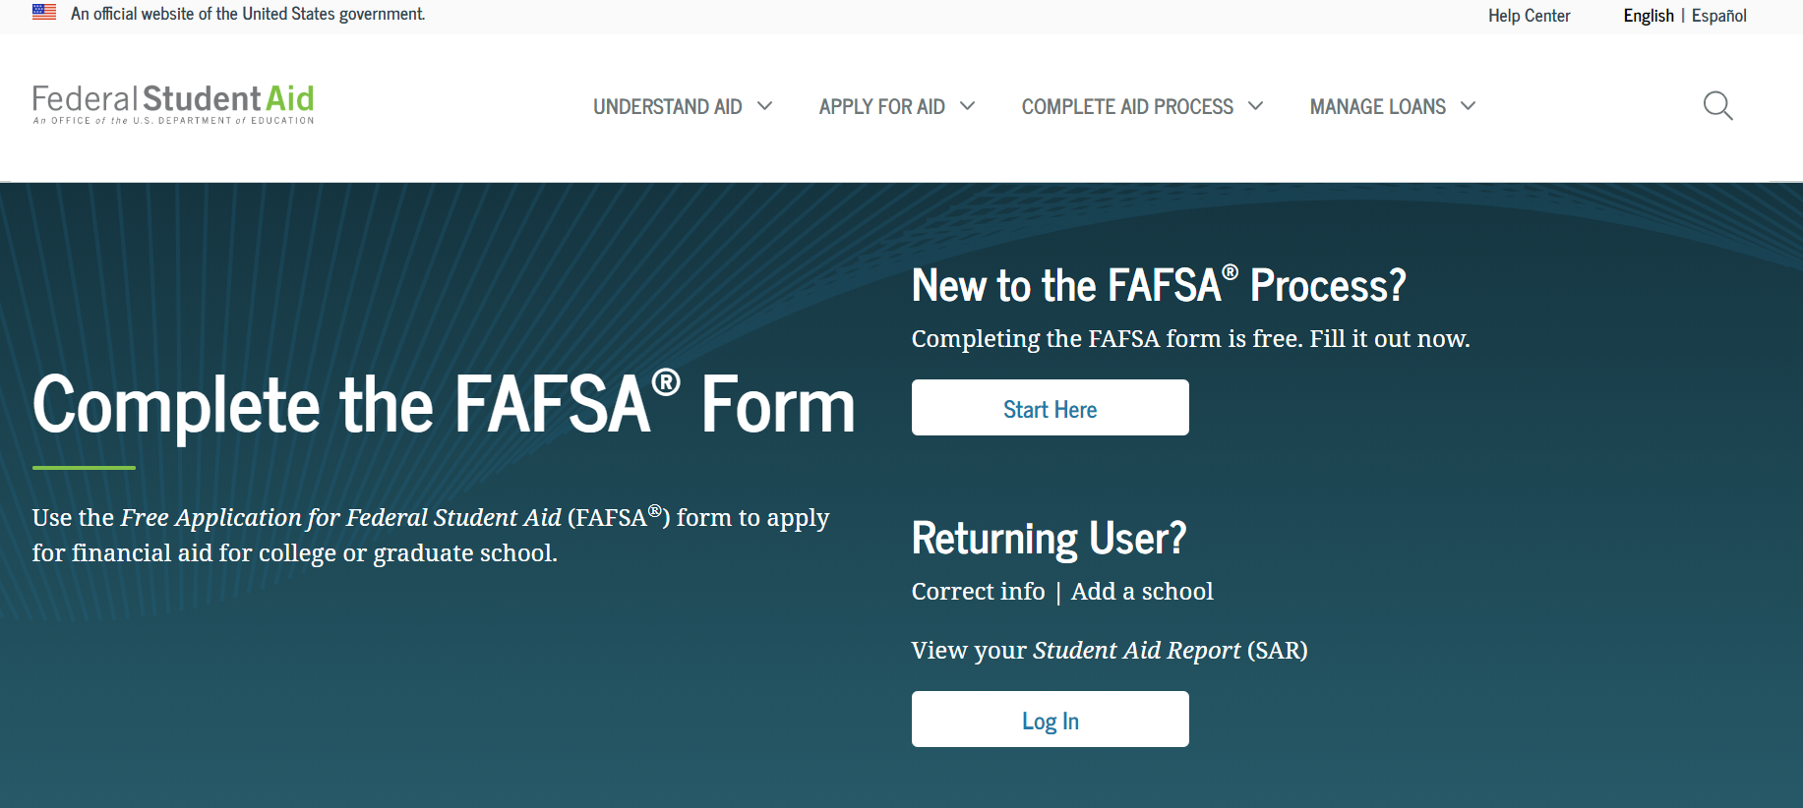
FAFSA.GOV
Help
Notes:
This is a screenshot of www.fafsa.gov. The reason that we show this screen shot is to ensure you are accessing the FREE website. If you feel that you need assistance in completing this application, there are built-in help resources available online. You can also reach out to a member of OSFA’s Outreach Services team, your high school counselor or a financial aid professional at your institution. We can all help you at no cost.

Slide 8
HOW MUCH WILL COLLEGE COST?
A student’s financial need is calculated as the difference between the cost of attending the school, the Cost of Attendance (COA) minus any expected financial assistance, such as gifts or outside scholarships, and the amount the student and their family is expected to pay, the Expected Family Contribution (EFC)
COA – EFC = Student Financial Need

Slide 9
College Costs
COA=Cost of Attendance varies from:
Institution to institution
In State vs. out of state
On campus vs. off campus
COA= Direct Costs + Indirect Costs
Net Price Calculator
Requirement for every institution
Notes:
The cost of attendance (COA) varies from institution to institution. There are also variances between in-state and out of state schools and whether the student lives on campus or off campus. It is important to take this into consideration when researching at your options.
Cost of attendance traditionally includes both direct and indirect costs.
Direct Costs include tuition and fees.
Indirect costs include items such as books, food, transportation, housing, and computer.
A Great Resource to utilize: Net Price Calculator
Every school is now required to have a Net Price Calculator available.
You can use the Net Price Calculator to assist in analyzing your COA-Cost of Attendance at a specific school.

Slide 10
College Costs
Public 2-year college (tuition and fees, in-state) - $3,770
Public 4-year college (tuition and fees, in-state) - $10,560
Public 4-year college (tuition and fees, out of state) - $27,020
Private 4-year college (tuition and fees) - $37,650
Source: The College Board
Notes:
As we outlined on the previous slide, college costs include both direct and indirect costs.
Let us briefly review the average direct cost which is only tuition and fees per year at different types of institutions.
According to the College Board: The Average Yearly Tuition and Fees,
Nationally, In Florida Your specific school Direct Cost will be lower than the national average.
(read slide)

Slide 11
Who can get federal student aid?
U.S. citizen/national or eligible noncitizen
High school diploma or equivalent
Eligible degree/certificate program in college/career school
Student has valid Social Security number
Males registered for Selective Service
Satisfactory academic progress in college/career school
Info about eligibility: StudentAid.gov/eligibility
NOT Just for Free & Reduced lunch students. Everyone needs to apply.
Notes:
**This is not a comprehensive list of eligibility criteria for federal student aid. For complete details, counselors may wish to visit ifap.ed.gov and go to the Student Eligibility chapter of the Federal Student Aid Handbook. (Students should visit StudentAid.gov/eligibility.)**
Basic eligibility criteria for federal student aid:
Demonstrate financial need (for most programs)
US citizen/national or eligible citizen such as a permanent resident (there are additional categories of eligible noncitizen; refer to Federal Student Aid Handbook for details)
High school diploma or the recognized equivalent (GED certificate, state certificate such as HiSET or California High School Exit Exam, or completion of at least a two-year program toward a bachelor’s degree, or the student must have academically excelled in high school); or homeschooler who has completed his/her home-school education as recognized by the state government; or enrolling in an eligible career pathway program and meeting one of the “ability-to-benefit” alternatives described at StudentAid.gov/eligibility/basic-criteria
Student enrolled as a regular student in a degree or certificate program that is eligible to be paid for by federal student aid funds; student also must be attending a college or career school that participates in the federal student aid programs
SSN: the exception here is students from the Republic of the Marshall Islands, the Federated States of Micronesia, or the Republic of Palau
Males (any person assigned the sex of male at birth) must register for Selective Service within 30 days of their 18th birthday (within 30 days before or 30 days after, for a total window of 60 days).
If you are working with a male student who did not meet the 60-day timeframe, direct him to register immediately at www.sss.gov. Late registrations are accepted until the age of 26.
If you are working with a male student aged 26 or older who did not register, you should direct him to the financial aid office at the college he plans to attend. Before he can receive federal student aid, he will have to prove that he did not “knowingly and willfully” fail to register. The financial aid administrator will tell him what documentation he needs in order to do so.
In broad terms, a student making satisfactory academic progress (SAP) is moving toward receiving his or her degree or certificate at a pace that is acceptable to his or her school. Each school sets its own SAP policy.

Slide 12
How do I apply for federal student aid?
Create a username and password called the FSA ID.
Learn about the FSA ID and find the link to create one at StudentAid.gov/fsaid.
You and your parent must each create your own FSA ID; you can’t share one.
If you provide an email address when creating your FSA ID, it must be a unique email address (can’t provide same email address for more than one person’s FSA ID).
Don’t tell anyone your FSA ID!
Notes:
Students and parents can create FSA IDs at any time. The student does not have to be ready to fill out a FAFSA form.
One benefit of creating an FSA ID is that you will be able to use it to sign the FAFSA form electronically, thus speeding up the process greatly.
Important to note here that student and parent need separate FSA IDs – one each. [Only one parent needs an FSA ID, even if both parents’ info will be provided on the FAFSA form.]
(To find out whether a parent’s information will be needed on the FAFSA form, a student can visit StudentAid.gov/dependency.)
It’s strongly encouraged that you provide an email address and mobile phone number when you create your FSA ID; this will help if you forget your username or password and need to reset it. It’s important to understand that your email address and phone number can be used for only one FSA ID. So for instance, if a parent and child share an email address, they’ll need to create a second one so that they’ll each have a unique email address to use when creating an FSA ID.
An FSA ID is a signature as well as providing access to private information. To protect themselves from identity theft and other types of fraud, students and parents should not tell anyone their FSA IDs.

Slide 13
How do I apply for federal student aid?
Gather the documents you need to apply.
Find checklist of what’s needed on infographic called “The FAFSA Process” at StudentAid.gov/resources#fafsa-process-graphic
You will be using 2021 taxes and financial information.
Notes:
The FAFSA Process infographic provides a visual overview of the process of filling out and submitting a FAFSA form, and what happens afterwards.
The FAFSA on the Web Worksheet provides an idea of the types of FAFSA questions. However, not every question on fafsa.gov appears on the worksheet.

Slide 14
How do I apply for federal student aid?
Apply at fafsa.gov. https://studentaid.gov/h/apply-for-aid/fafsa
Apply on or after October 1 but as early as possible to meet all deadlines. OPEN now, START NOW!
State deadlines are at fafsa.gov.
School deadlines are listed on schools’ websites.
Use your (student’s) FSA ID to start the application; saves time and confusion.
Make sure you add ALL schools(college/technical) your student is interested in.
Notes:
The FAFSA form is available online (in English or Spanish) October 1 of each year for the next school year. A high school student will (ideally) apply in October of his/her senior year, assuming he/she plans to go on to college in the fall following graduation.
Many state education agencies and schools also use information from the FAFSA form in order to determine eligibility for their programs. Their deadlines can be quite early, so the student should check the FAFSA site for the state deadline as well as finding out each school’s deadline.
It’s STRONGLY encouraged for a student to start the application at fafsa.gov with his or her FSA ID when give the option between entering the student’s FSA ID and entering the “student’s information” (meaning name, date of birth, etc). Using the FSA ID prefills some info in the form, automatically signs the form for the student, and avoids the problems caused if the student enters “student information” that’s different from what he or she has in his or her FSA ID account. ***This is a top FAFSA tip. A lot of people have problems because they enter different info in the FAFSA form vs their FSA ID account, and it’s easy to avoid this problem.***
fafsa.gov provides help screens and live chat with a customer service representative (during business hours). Additionally, the 1-800-4-FED-AID hotline can guide the student through the FAFSA form. Operators speak English and Spanish.
Students need to understand that they have not finished with the application until they have submitted it and have a confirmation page on the screen.
Printed-out FAFSA PDFs can take as much as 2.5 weeks longer to process than the online FAFSA form.
[Note to counselors: The IRS Data Retrieval Tool is returning with the 2018-19 FAFSA cycle. To address privacy and security concerns, the tax return information will be encrypted and hidden from the borrower's view on the IRS DRT web page, as well as on fafsa.gov and on the student’s Student Aid Report provided by the government after the student applies.]

Slide 15
How do I apply for federal student aid?
Watch for response by email or by mail, confirming that your FAFSA form was processed. You should receive a Student Aid Report (SAR) which will give your Estimated Family Contribution (EFC) and the maximum Federal Aid you qualify for.
Double-check that your info is correct by logging on at the FAFSA site and reviewing your data.
Correct any mistakes and submit the corrected info.
Don’t update info that was correct on the day you signed your FAFSA form.
Notes:
The online or paper Student Aid Report (SAR) will list the student’s EFC and will show the information the student reported on the FAFSA form (except for tax info imported via the IRS DRT). The student can review the FAFSA information online by logging in at fafsa.gov.
Corrections can be made online at fafsa.gov or on the paper SAR. Online corrections can be processed immediately in some cases. The student will then receive a new SAR, and the school will receive updated information.

Slide 16
Student Dependent or Independent?
At any time on or after July 1, 2022, did the director of an emergency shelter or transitional housing program funded by the U.S. Department of Housing and Urban Development determine that you were an unaccompanied youth who was homeless or were self-supporting and at risk of being homeless?
At any time on or after July 1, 2022, did the director of a runaway or homeless youth basic center or transitional living program determine that you were an unaccompanied youth who was homeless or were self-supporting and at risk of being homeless?
Notes:
(these two questions were addressed on the previous slide)

Slide 17
Student Dependent or Independent?
If the student can answer “yes” to any of these questions, then they are considered independent and do not need parents’ financial information for FAFSA:
As of today are you married?
Are you currently serving on active duty in the U.S. Armed Forces for purposes other than training?
Do you now have, or will you have, children who will receive more than half of their support from you during 2021 tax year?
Do you have dependents other than your children or spouse who live with you and who receive more than half of their support from you, now and through June 30, 2022?
At any time since you turned age 13, were both your parents deceased, were you in foster care, a dependent, or ward of the court?
As determined by a court in your state of legal residence, are you or were you, an emancipated minor?
Notes:
The US DOE identifies students dependency status based on the following questions:
If you can answer Yes to any of the following questions, you are considered an independent student on the 2018-19 Free Application for Federal Student Aid (FAFSA), and you generally will not need to provide your parents’ information.
However, if you can answer No to all of the following questions, you are considered a dependent student and generally your parents must provide parental information on your FAFSA.
Read Slide

Slide 18
Student Dependent or Independent?
Does someone other than your parent or stepparent have legal guardianship of you, as determined by a court, in your state of legal residence?
At any time on or after July 1, 2022, did your high school or school district homeless liaison determine that you were an unaccompanied youth who was homeless or were self-supporting and at risk of being homeless?
At any time on or after July 1, 2022, did the director of an emergency shelter or transitional housing program, funded by the U.S. Department of Housing and Urban Development, determine that you were an unaccompanied youth who was homeless or were self-supporting and at risk of being homeless?
At any time on or after July 1, 2022, did the director of a runaway or homeless youth basic center or transitional living program determine that you were an unaccompanied youth who was homeless or were self-supporting and at risk of being homeless?
Notes:
Read first two bullet points and then add:
The next few questions pertain to applicants who are designated as being:
Homeless
An unaccompanied youth
Self-supporting
At risk of being homeless
All designations are to be documented by one of the following:
Director of an emergency shelter
Director of a transitional housing program
High school homeless liaison

Slide 19
Where can I get more info?
StudentAid.gov
Info about aid programs
Links to free scholarship and college searches
1-800-4-FED-AID or studentaid@ed.gov
Info about aid programs
Help with FAFSA form
Toll free # 1-800-730-8913

Slide 20
Who is a Parent?
A legal parent includes a biological or adoptive parent, or a person that the state has determined to be your parent (for example, when a state allows another person’s name to be listed as a parent on a birth certificate).
Grandparents, foster parents, legal guardians, older brothers or sisters, widowed stepparents, and aunts and uncles are not considered parents unless they have legally adopted you.
Notes:
Read slide
Parents’ Marital Status – often there is confusion regarding the marital status of parents and how to report a parent on the FAFSA.
If the parents’ marital status is:
Never Married: include the parent that you lived with most during the last 12 months. If you did not live with one parent more than the other, provide information about the parent who provided more financial support during the last 12 months or during the most recent year that you actually received support from a parent.
Unmarried and both parents living together: include both of your parents
Married: include both of your parents
Remarried (after being widowed or divorced): include the parent and stepparent
Divorced or separated: include the parent that you lived with most during the last 12 months. If you did not live with one parent more than the other, provide information about the parent who provided more financial support during the last 12 months or during the most recent year that you actually received support from a parent
Widowed: include the parent who is living

Slide 21
Student Aid Report (SAR)
Provides basic information about federal student aid eligibility
Received (after you submit the FAFSA) via email within 3-5 days if you provided an email address
Received via mail within 7-10 days if you did not provide an email address
Correct errors, if needed
Will contain an expected family contribution (EFC)
Assists institutions in the financial aid award packaging process
COA-EFC=Financial need
Cost of attendance less expected family contribution = financial need
Notes:
Once you submit your FAFSA you will receive a SAR (Student Aid Report)
It is important to ensure that the SAR is received and reviewed according to these timeframes. If the SAR is not received, the student must investigate why it has not been received. It may be in a spam folder, it may have not processed correctly due to an error, etc. When the student receives their copy of the SAR, the institution(s) will receive an electronic version referred to as an ISIR.
If corrections need to be made, the student should work with a financial aid administrator to determine who will make the corrections (student or school). If a student needs to make corrections, they will do so online at www.fafsa.gov.
The institution will review the SAR for accuracy and begin the financial aid award process. The EFC is used to award need-based aid. As outlined on the slide, cost of attendance – expected family contribution = financial need. An institution will begin layering a financial aid package in an effort to cover the entire cost of attendance. As the cost of attendance can vary from institution to institution, it is important that students and families apply for all federal, state, institutional and local resources in an effort to assist the institution in building a strong financial aid package.

Slide 22
Additional Information
Contact institution to determine award disbursement process
Contact institution for special circumstances or professional judgment needs
Contact institution to determine what other types of aid applications are available
Use student loans as a LAST RESORT
Notes:
Students must contact their institution to determine the award process. For example, one institution may email the student. Another may require the student to log-in to a student portal and check their status online. The student must monitor the process closely! Otherwise, they may miss out on key deadlines or funding.
If students and families complete the FAFSA and are concerned that the form does not reflect their current situation, they may contact a financial aid administrator to discuss their specific needs. Professional judgment and/or Professional Judgement are optional and schools have the direct authority in this area.
Students can also contact the institution to determine what other aid applications are available. An institution may have a foundation department that has a separate application and funding process that students may want to apply for. Additionally, department chairs may have access to not only institutional funds, but may also have access to other industry-based resources students can apply for.
Lastly, student loans are often included in the initial award process. Students have a right and responsibility to determine if they should accept, decline or reduce any student loan or loans being offered. Students should borrow conservatively. It’s important to live frugally while in college. If a student does not borrow conservatively and live frugally, he/she will struggle throughout student loan repayment.

Slide 23
Additional Information
Verification Process
Financial Aid Award Notification
Communication with the Post Secondary Institution
Formula: COA-EFC = Financial Need
Scholarships/Grants (Institutional/Federal/State)
Florida Prepaid-529 Plans (Check with your Institution)
Federal Loans: Student/Parent
Subsidized (USDOE pays interest – in school)
Unsubsidized (Student responsible interest)
Subsidized/Unsubsidized (Principal + interest begins after graduation or not enrolled for 6 months)
Private Loans
Notes:
Students must contact their institution to determine the award process. For example, one institution may email the student. Another may require the student to log-in to a student portal and check their status online. The student must monitor the process closely! Otherwise, they may miss out on key deadlines or funding.
If students and families complete the FAFSA and are concerned that the form does not reflect their current situation, they may contact a financial aid administrator to discuss their specific needs. Professional judgment and/or Professional Judgement are optional and schools have the direct authority in this area.
Students can also contact the institution to determine what other aid applications are available. An institution may have a foundation department that has a separate application and funding process that students may want to apply for. Additionally, department chairs may have access to not only institutional funds, but may also have access to other industry-based resources students can apply for.
Lastly, student loans are often included in the initial award process. Students have a right and responsibility to determine if they should accept, decline or reduce any student loan or loans being offered. Students should borrow conservatively. It’s important to live frugally while in college. If a student does not borrow conservatively and live frugally, he/she will struggle throughout student loan repayment.

Slide 24
www.FloridaStudentFinancialaid.org
Notes:
The next few slides contain screenshots of what the OSFA website looks like.

Slide 25
Florida Bright Futures Program
Florida Bright Futures Scholarship (BF) MUST earn 100/75 Volunteer hours OR Paid Work hours for 100%/75% of State school tuition costs
ACT score 29 composite for 100% or 25 composite for 75%
SAT needs a 1330 for 100% or 1210 for 75%
Student Handbook
Chart of Eligibility and Award Criteria
Notes:
BF - Provides scholarships based on high school academic achievement and is Florida’s largest merit-based scholarship program. To be considered, students must submit a completed (error free) Initial Student Florida Financial Aid Application (FFAA) during their senior year of high school (after October 1st and prior to August 31). Students graduating mid-year must submit the completed FFAA by August 31st of their graduation year (prior to the spring term enrolled).
(PRESENTER: Print out Student Handbook and Chart of Eligibility and Award Criteria for additional speaking points during this part of the presentation in case specific questions are asked about this scholarship (i.e., test scores, community service hours, etc.)
Benacquisto–is a merit scholarship for Florida high school graduates and non-Florida residents who receive recognition as a National Merit® Scholar.
Eligible scholars will receive an award, which is equal to the institutional cost of attendance minus the sum of Bright Futures and the National Merit award. An initial application is not required.

Slide 26
Bright Futures 2022-2023 Criteria

Slide 27
Volunteer Hours/Paid Work Hours for Bright Futures
Not needed for graduation
Needed for Bright Futures
Forms turned into your counselor
Goal should be to complete 100 hours
Paystub needed for work hours
Two forms required for volunteer activities:
Service Plan
Service Log
Signed letter on the organization’s letterhead required for any activities outside of the school describing type of service, who in the community the service benefited and a description of the service event.

Slide 28
Community Service Forms Pick up in School Counseling Office

Slide 29
Other Florida Grants
First Generation Matching Grant (FGMG)
Florida Farmworker Student Scholarship (FFSS)
José Martí Scholarship Challenge (JM)
Mary McLeod Bethune (MMB)
Minority Teacher Education Program Scholarship (MTES)
Rosewood Family Scholarship (RFS)
Scholarships for Children and Spouses of Deceased or Disabled Veterans (CSDDV)
Notes:
FGMG - Provides grant funding to Florida resident, undergraduate students enrolled at state universities or Florida Colleges (also known as public community colleges), who demonstrate financial need, and whose parents have not earned baccalaureate degrees.
Jose Marti - Provides scholarship assistance to Hispanic-American students who meet scholastic requirements and demonstrate financial need. Applicants for undergraduate study must apply during their senior year of high school. To be considered, high school seniors must submit the FFAA by April 1st and a processed FAFSA by May 15th. Awards are made until the allocation has been depleted.
Please refer to the Jose Marti fact sheet online for specific requirements.
MMB – Provides scholarship assistance to undergraduate students who meet academic requirements, demonstrate financial need, and attend on of the following universities:
Bethune Cookman University
Edward Waters College
Florida Agricultural and Mechanical University
Florida Memorial University
MTES - Provides scholarship funding for African-American, Hispanic-American, Asian-American, and Native-American students who indicate the potential to become good teachers. To be considered, students must apply via the Florida Fund for Minority Teachers website at www.ffmt.org.
RFS – Provides scholarship assistance to a maximum of 50 direct descendants of Rosewood families affected by the incidents of January 1923.
CSDDV – Provides scholarship assistance for dependent children and spouses of Florida veterans who:
Died as a result of services connected injuries, diseases, or disability sustained while on active duty
Have a service connected 100% total and permanent disability
Are classified as a prisoner of war or missing in action by the Armed Forces of the U.S.
The Florida Department of Veteran’s Affairs will certify a veteran’s eligibility.

Slide 30
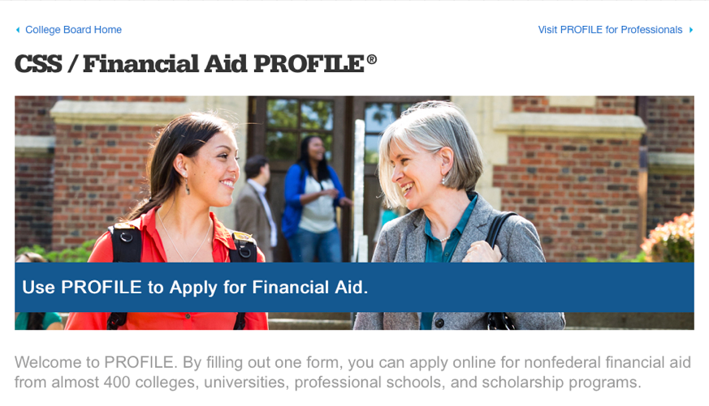
Financial Aid PROFILE
The PROFILE is a tool created by the College Board that allows students to complete one form and apply online for non-federal financial aid from almost 400 colleges, universities, professional schools, and scholarship programs.
https://student.collegeboard.org/css-financial-aid-profile

Slide 31
https://opportunity.collegeboard.org/

Slide 32
Be Smart About Scholarships
Thousands of scholarships exist. Some colleges automatically consider all applicants for scholarships. Other scholarships from colleges, universities, and private sources require special applications and additional work and motivation to make it happen.
Never pay money to apply to an outside scholarship.
Resource: Goingmerry.com

Slide 33
GoingMerry.com ( One stop shop for scholarships )

Slide 34
Fastweb
1.5 million scholarships worth 3.4 billion dollars
Targeted search
Other resources
College search
Career planning
And more!
www.fastweb.com
Notes:
Fastweb works by matching the information in your completed profile to scholarships contained in their database. Besides providing you with scholarships you actually qualify for, and eliminating the need to scour the web, Fastweb also provides advice on financial aid, college admissions, student life and tools such as financial aid calculators, discussion boards, and checklists.
TIP- Set up a separate email account solely for scholarship searches to prevent your personal inbox becoming inundated with information.

Slide 35
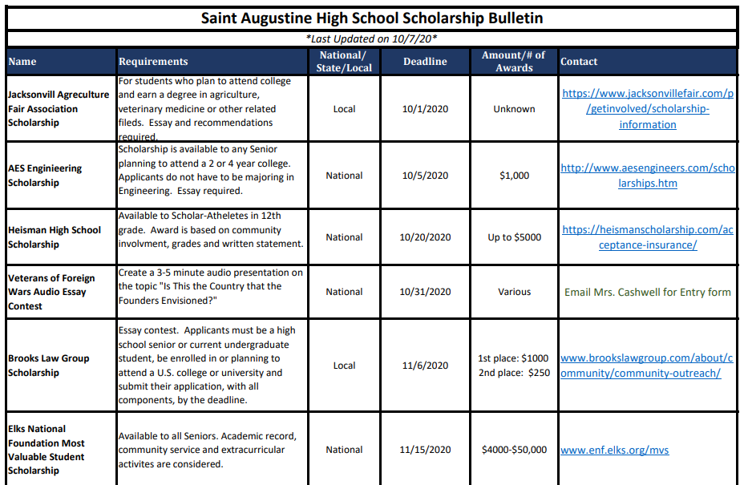
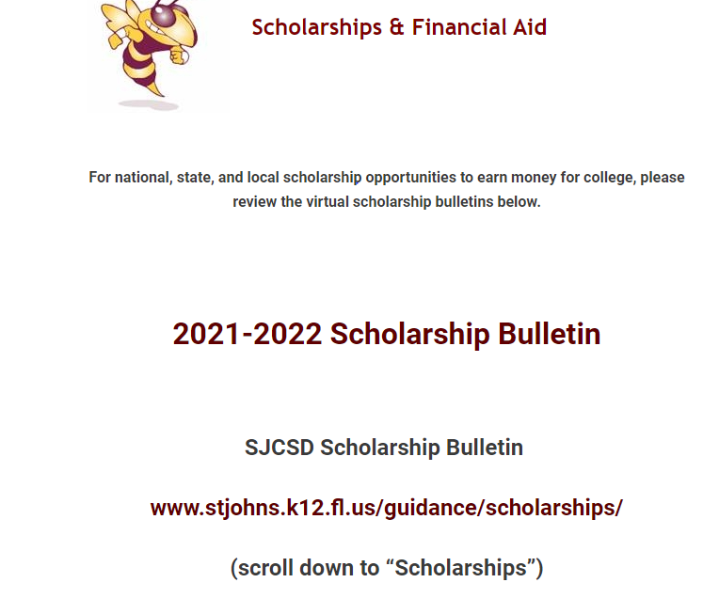
Check out SAHS Scholarships page.

Slide 36
Review: Action Items
Federal – Financial Aid (FAFSA) www.FAFSA.org
October 1, 2022 is FAFSA application opening date
Create FSA ID and passwords now
State – Financial Aid (FFAA) www.FloridaStudentFinancialAid.org
October 1, 2022 as application opening date
Ensure you are meeting requirements:
Bright Futures
Graduation
Private and Local scholarships – apply, apply, apply!
Notes:
In conclusion, let’s review what we’ve discussed and create an action plan for you.
(Read slide.)
Reminder:
Students graduating early and seeking funding for the spring term must submit the FFAA by August 31 PRIOR TO the intended graduation date. There are NO EXCEPTIONS to this application deadline. If a student does not graduate mid-year as planned and wishes to apply as an end-of-year graduate, the student must submit a new FFAA after the new application opens on October 1.

Slide 37
Office of Student Financial Assistance (OSFA) Contacts
Email:
osfa@fldoe.org
Telephone:
1-888-827-2004
OSFA Director Outreach Services:
Pete Hernandez | 850.245.1821 | Pedro.Hernandez@fldoe.org
Notes:
If you need assistance or further information, please do not hesitate to contact us. We are here to help!
Thank you for attending this presentation. We hope you have a successful transition into postsecondary education.

Slide 38
QUESTIONS?

