Slide 1
Cambridge A.I.C.E. Advanced International Certificate of Education
St. Augustine High School
Welcome!

Slide 2
Introductions
Mr. Travis Brown, Principal
Ms. Michelle Davis, Assistant Principal
Ms. Twila Needham, Assistant Principal
Mr. Earl Brown, Assistant Principal
Ms. Bechtle, AICE School Counselor/Program Coordinator
Ms. Cashwell for 2024 – 25 forward
Ms. Tresca Esguerra, AICE Clerk/Exams Officer
Dawn Eakins, College & Career Counselor/Exams Officer
AICE/Pre-AICE Teachers

Slide 3
A.I.C.E. at St. Augustine High
St. Augustine High started the Cambridge A.I.C.E. program in 1997.
SAHS was the 2nd school in the US to begin an A.I.C.E. program.
Rigorous and Flexible Curriculum
Writing based
Critical Thinking

Slide 4
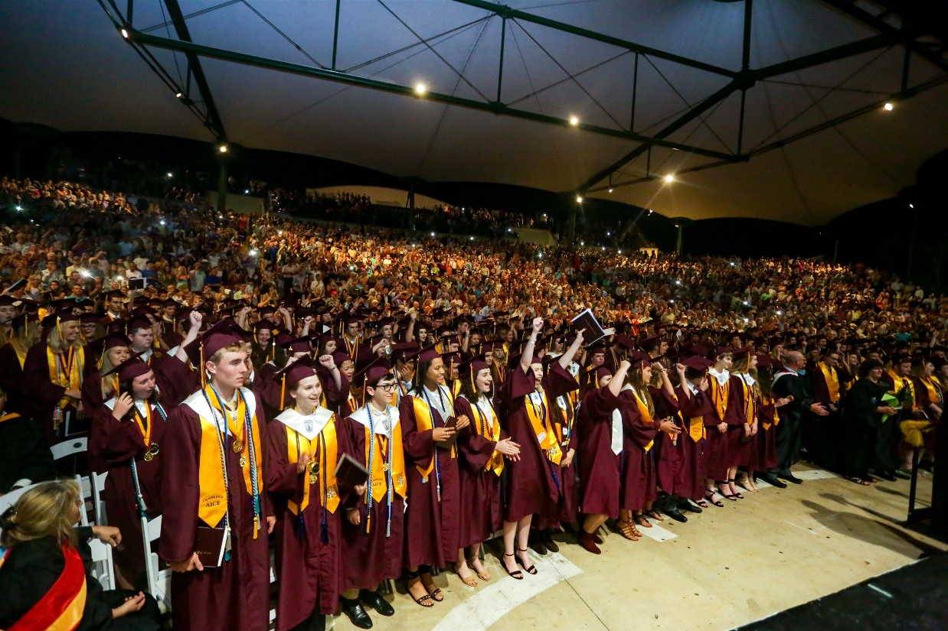
Why A.I.C.E.?
Flexible Curriculum
Future Predictor of College Success
FSU Study
GPA Points
College Credit
Bright Futures

Slide 5
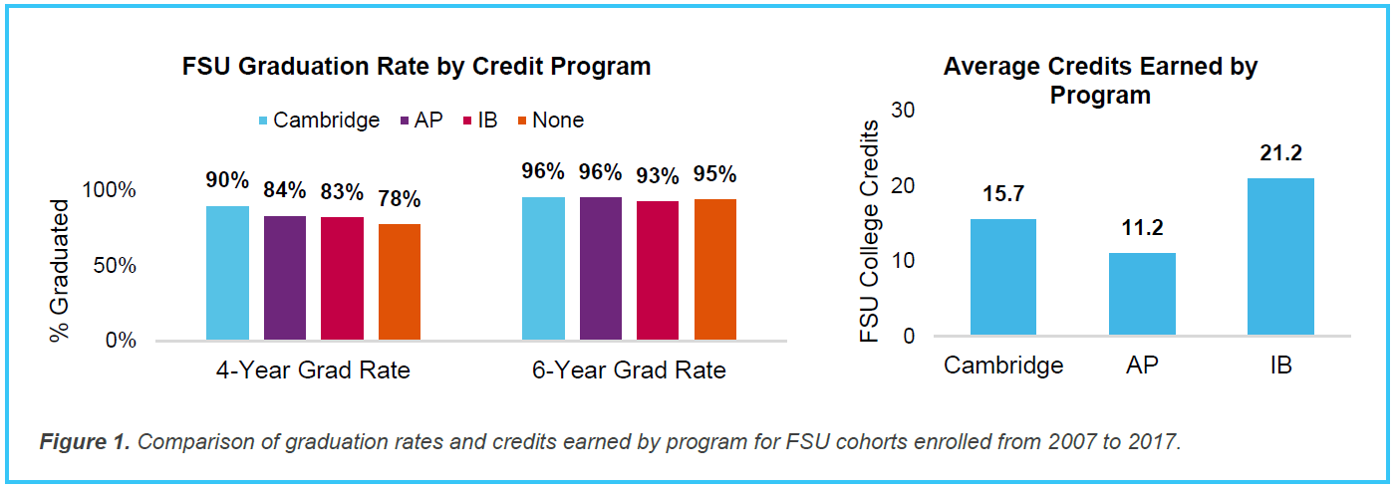
FSU Study – Grad. Rates
Notes:
Graduation data show that 90 percent of Cambridge students enrolled at FSU graduate within 4 years. The 4-year graduation rate for Cambridge students is much higher than students who enrolled at FSU with no credit via advanced high school programs (90 percent versus 78 percent). Cambridge students completed their bachelor’s degrees in an average of 3.8 years.
Moreover, a higher percentage of Cambridge students completed their bachelor’s degrees in four years compared to peers who earned college credit via other advanced coursework programs. This result is particularly impressive when comparing the number of FSU credits students receive from their high school advanced courses: a higher percentage of Cambridge students are graduating on time compared to peers who receive a comparable amount of credits from other programs.

Slide 6
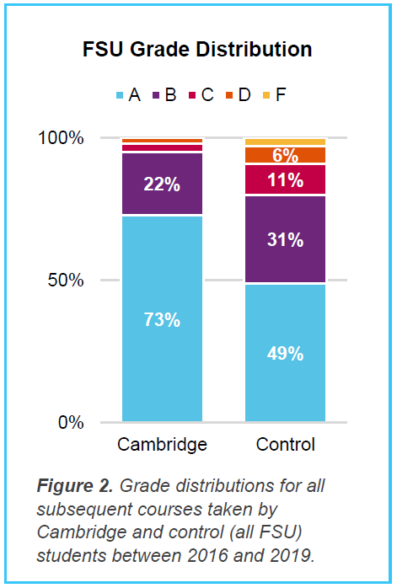
FSU Study – Grade Distribution
Notes:
Overall, 98 percent of grades achieved by Cambridge students in their subsequent FSU courses were passing grades (above a C or 2.0 GPA) compared to 91 percent for the total cohort of students.
Cambridge students tended to achieve higher grades: 73 percent of Cambridge students receiving college credit achieved an A in their subsequent course while 49 percent of the control (all students) earned an A.
Preliminary analyses suggest that students who score an E on their A or AS Levels continue to do well in college. Approximately 92 percent of students who scored an E on their A/AS Level went on to achieve an A or B grade in the relevant subsequent course in college. This result suggests that students scoring the minimum A/AS Level grade (E) still perform extremely well in their subsequent college courses.

Slide 7
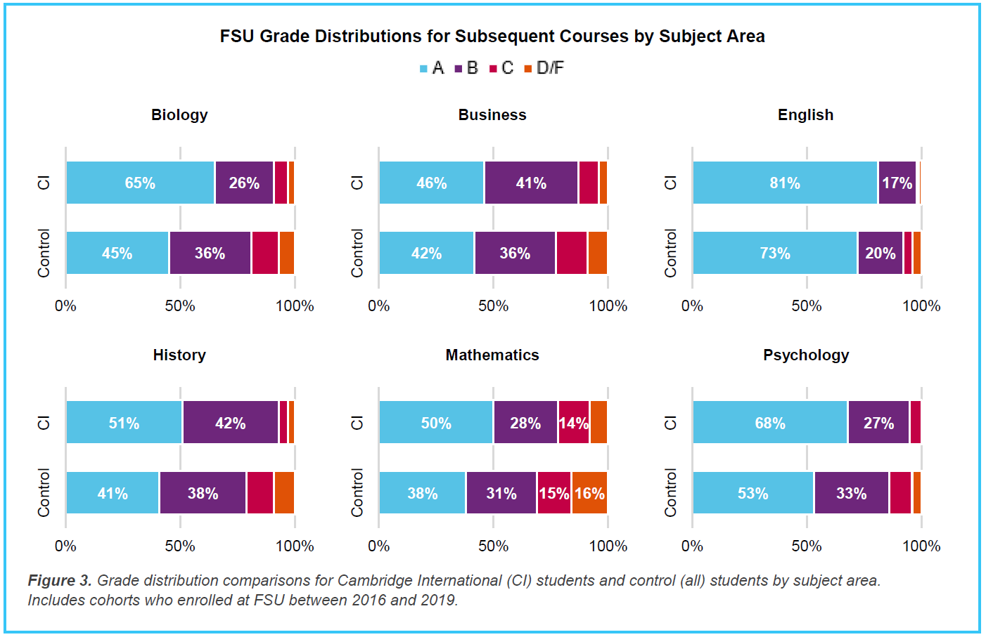
College Grades Earned
Notes:
In six subject areas (Biology, Business, English, History, Math, and Psychology), Cambridge students again performed well and followed a pattern of high achievement, with a higher proportion of Cambridge students achieving A grades in all 6 subject areas compared to the control group (all students). For example, Cambridge students achieved an A grade in 65 percent of the subsequent Biology courses compared to 45 percent for the control. This again suggests that students who received credit for their Cambridge International AS and A Levels are well prepared for high achievement in their subsequent college courses.

Slide 8
AICE Exam Results at SAHS June 2023 Exam Session
Overall, SAHS AICE Exam pass rate = 70%
ADIP’s earned
Class of 2023 = 97 ADIP’s = 90%
65% earned “with Merit”
12% earned “with Distinction”
65 (75%) in June 2023 exam session (11th & 12th)
58% earned “with Merit”
4 candidates earned “with Distinction”
Notes:
Nat’l ADIP pass rates were not provided

Slide 9
Celebrations!
Pass rate celebrations:
English Gen. Paper = 97%
English Lit. (AS & AL combined) = 91%
Global Perspectives = 99%
Thinking Skills = 95%
Music = 100%
Math = 85% (AL Math = 100%)
Environmental Mgt. = 80%
Spanish Language = 89%

Slide 10
Results Analysis
9 new teachers to AICE subjects in 2022-23
Cambridge increased the rigor of evaluation
Has been increasing since Covid years
More students successful at earning their ADIP at the end of junior year
Notes:
6 AS Subjects did not beat the nat’l pass rate – 3 of those were being tested in person for the 1st time at SAHS (Drama, Music, PE)
Only 5 students took the AL Math – but all passed!

Slide 11
Expectations in AICE
DO
DON’T
Expect to struggle! (If you’re not challenged, you’re not growing!!)
Remain Organized
Keep up with your work
Ask teachers for help
Use outside tutors
Reach out to friends
Try different solutions/study methods
Dismiss a low grade
Focus on the exam results
Get discouraged with a low grade – figure it out!
Try to “fix” the problem yourself
Engage in harmful attitudes or blaming others
Blame the “teaching style”
DON’T Give Up!

Slide 12
What do I need to graduate from High School?
Standard Graduation Path:
3 basic requirements:
Earn 24 Credits
Earn a 2.0 GPA
Pass 2 state assessments (tests)

Slide 13
Standard (Non-AICE) Graduation Requirements
4 English
4 Math
3 Social Studies (World, US History, Gov’t/Econ.
3 Science
.5 Financial Literacy
7.5 Electives
Notes:
AICE Curriculum requirements/differences will be covered later...

Slide 14
Two Tests
10th Grade ELA (English Language Arts) FAST
State Math Assessment

Slide 15
AICE Course Options
AICE English (all 4 years)
AICE Global Perspectives (11th grade)
Options for subject categories
AICE Students CAN take DE Courses

Slide 16
A.I.C.E. Curriculum Requirements VS. Cambridge A.I.C.E. Diploma Award
What’s the Difference?

Slide 17
Graduation Requirements for the A.I.C.E. Curriculum
AICE Curriculum
COMPLETE* Seven A.I.C.E. level courses with at least one in each academic category
“Complete” means = *1. earn a passing grade in the course and
2. “sit for” (take) the FULL Cambridge exam at the end of the course. *1. earn a passing grade, 2. “sit for” (take) the FULL exam
Academic Categories:
Language
Math/Science
Humanities
The “Core”
Optional Category – Interdisciplinary Studies

Slide 18
Subject Categories
Math & Science Languages Arts & Humanities
Math (AS/AL) English Language AS English Literature AS
Marine Science (AS/AL) English Language AL English Literature AL
Physics (AS/AL) Spanish Language US History
Chemistry (AS/AL) International History
*Environmental Management Music (AS/AL)
*Psychology (AS/AL) Drama (AS/AL)
Physical Education **Art & Design (AS/AL)
Dig. Media & Design (AS/AL)
Economics (AS/AL)
Core (required) Optional Interdisciplinary Cat.
Global Perspectives English General Paper Thinking Skills **Art & Design is offered in
Global Perspectives AL Draw/Paint or Ceramics

Slide 19
Graduation Requirements for the A.I.C.E. Curriculum
AICE English required all 4 years
Global Perspectives required 11th grade year
AICE Curriculum Completers = Exempt from HOPE, Fine Arts, American Government and Economics
PASSING AICE Exams is NOT required for graduation!
Must meet course progression requirements for university entry
(i.e., 4 (AICE) English, 2 World Language, 3 Science, 3 Social Studies, 4 Math)

Slide 20
Cambridge A.I.C.E. Diploma Award
The A.I.C.E. Diploma Award (ADIP) is an internationally recognized AWARD for academic rigor
Must Pass seven (7) A/AS Level Exams
Pass at least 1 exam in each category (grade of “a” – “e”)
25-month time period for award calculation
Automatically qualified for Florida Academic Bright Futures Scholarship (top level)
Must have 100 hours logged
GPA and ACT/SAT requirement waived

Slide 21
Exam Sessions/Options
June Exam Session: Cambridge Exam after course
November Exam Session = retakes, some ADIP if eligible
A Level = 2nd year of a subject, “Carry Forward”, or re-take all
Teachers have June Results
Students will receive indiv. Login/password info. after every exam session
25-month timeframe for ADIP
Preliminary June 2024 Exam Schedule – April 26 - June 13th

Slide 22
Bright Futures
Florida Scholar Award (FSA - top level)
Pays 100% of tuition
ADIP Earners
SAT/ACT Score requirement waived
GPA requirement waived
Service Hours – NEW procedures
100 Hours for FSA
Use Community Service form, Plan & Reflection Log
Non-Profit organizations only

Slide 23
Community Service Hours
C.S. form and Reflection Log - available in School Counseling, posted to Jacket School Counseling Schoology and AICE Schoology
Plan/Reflection log required for ALL organizations
(school based AND outside of school)
Signature can be provided directly on Log for School based volunteer hours
ALL hours completed at an outside organization:
Letter from organization on letterhead (in addition to Plan & Reflection Log)
Name of Organization
Your Name
Activity & number of hours volunteered
Signature

Slide 24
Community Service Hours
NEW: Paid work hours can be used for Bright Futures!
Must submit a pay stub – see the new CS Forms for rules
Volunteer Service Plan and Reflection Log must be turned in with CS form
Turn in ALL hours/forms to Ms. Esguerra when you have accrued 25 hours on one form/letter
(or by the end of 1st semester of senior year at the latest).

Slide 25
AICE Exams in College
Exam scores may be self-reported during admissions application process
Each exam passed = college credit earned
ALL FL Public Colleges accept/award college credit for passing scores on AICE Exams

Slide 26
AICE Exams in College
Private and out-of-state colleges will have their own policy about credit-by-exam (AICE, IB, and DE) - CHECK!!
Taking (& doing well in) the COURSES = admissions advantage - gets you in the door!
Cambridge Electronic Transcript Request = submit in Feb./March of senior year, after decision is made!

Slide 27
In a Nutshell
FLEXIBLE
Explore Multiple Interests in HS
College Admissions Advantage
Head start on College Credits
Skills for College Success

Slide 28
What’s Happening in A.I.C.E.?
AICE Advisory Board – Club for AICE students/parents. Meets Thurs. 8:45am E503
College Tours (?)
Fund Raisers
Community Service
AICE Game Day
Student inspired activities
AICE Booster Club – Supporting AICE Students
Monthly meetings (see emails)
Organize Fund Raisers
Promote AICE
Provide support materials, funding for events, “Angel Fund”
AICE Website – all PPT presentations, exam info., etc.
AICE Schoology Group – All AICE Students are part of this group

Slide 29
Parent Accounts: HAC & Schoology
Schoology:
https://www.stjohns.k12.fl.us/media/edtech/schoology/schoology-for-parents/
HAC:
https://www.stjohns.k12.fl.us/hac/

Slide 30
Handouts Available in AICE Schoology page - AICE Parent Night Resources Folder
AICE Course Progression
AICE Fact Sheet
AICE Brochure
FSU/Cambridge Study
Bright Futures/Service Hours new info./forms
AICE Booster Club Information
This PowerPoint presentation

Slide 31
Contact Information
Dena Bechtle
904-547-8533, Dena.Bechtle@stjohns.k12.fl.us
Tresca Esguerra
904-547-8523, Tresca.Esguerra@stjohns.k12.fl.us
Dawn Eakins
904-547-2013, Dawn.Eakins@stjohns.k12.fl.us
Michelle Davis
904-547-8513, Michelle.Davis@stjohns.k12.fl.us
Earl Brown
904-547-8847, Earl.Brown@stjohns.k12.fl.us
Twila Needham
904-547-8844, Twila.Needham@stjohns.k12.fl.us
Travis Brown
904-547-8510, Travis.Brown@stjohns.k12.fl.us

Slide 32
Questions?
Ms. Bechtle, Ms. Esguerra – AICE Program, Exams, ADIP, etc.
AICE Student Volunteers – “real life” AICE
Ms. Eakins – Dual Enrollment, college applications, FAFSA, AICE Exams
Ms. Davis – Curriculum, etc.

