Slide 1
AICE Sophomores

Slide 2
NEWS YOU NEED!!
Online Appointment Request for School Counselor appointments
(SAHS website)
Follow @JacketSchoolCounseling on Instagram
AICE Schoology & Yellow Jacket School Counseling – enable notifications
Notes:
Post REMIND info., pass around Tutor Lists

Slide 3
June 2023 Exam Session
Statement of Entry – WHITE (you keep this!)
Name, DOB, gender
Do the exams match your AICE courses?
Issues? Add them to the corrections list
Did you take the AS Eng. Lang. exam last year? If not – should have all 4 Papers on SOE
Exam Schedule – YELLOW (you keep this!)
Find ALL of your Papers, highlight, put them in your phone, planner, etc.
Any conflicts – follow “conflict” schedule that day

Slide 4
June 2023 Exam Session
Exam Letter – PINK (Complete & TURN THIS ONE IN!!!)
READ!!!
Have your parents READ it!
Student signature, parent signature – DUE TO MS. MOLONEY BY FRIDAY FEB. 3rd!!!
Add any re-takes (payment can be made later)
Exam Letter must be completed/turned in even if you’re NOT ordering anything!!
Retake section (bottom)

Slide 5
Exam Reminders
Students are required to sit for the Cambridge exam (ALL papers) in lieu of their final exam for each AICE course.
What does it mean to “sit for” a Cambridge exam?
What if you don’t show up for the Cambridge exam (or any part of it)?
Alternate final exam for that course, = new semester grade calculated.
“Owe” list for the exam fee ($110.10)– preventing you from buying prom tickets, getting your diploma, etc. until that amount is paid.
That AICE course cannot be counted towards graduation.
What if a Cambridge exam conflicts with a SAHS final exam?
Attend the Cambridge exam & go to the make-up exam time for your final.
The exam schedule is available via AICE teachers, on the AICE Website, and AICE Schoology or pick one up from Ms. Moloney if you lose yours!

Slide 6
Graduation Requirements for the AICE Curriculum
AICE Curriculum
Complete* Seven A.I.C.E. level courses with at least one in each academic category
“Complete” means = *1. earn a passing grade in the course, 2. “sit for” (take) the FULL exam
Academic Categories:
Language
Math/Science
Humanities
The “Core”
Optional Category – Interdisciplinary Studies

Slide 7
Exam Reminders (cont’d)
No make-up days
Can’t change any of the dates/times
All morning exams = 8:45am; afternoon exams = 12:45pm. This is the START TIME for the exam
PLAN TO ARRIVE AT LEAST 20 MINUTES BEFORE START TIME!
Students MUST remain in the exam room for the entire exam time!!
Conflict Schedules - how do those work?
What if you’re sick?
What if you’re late?

Slide 8
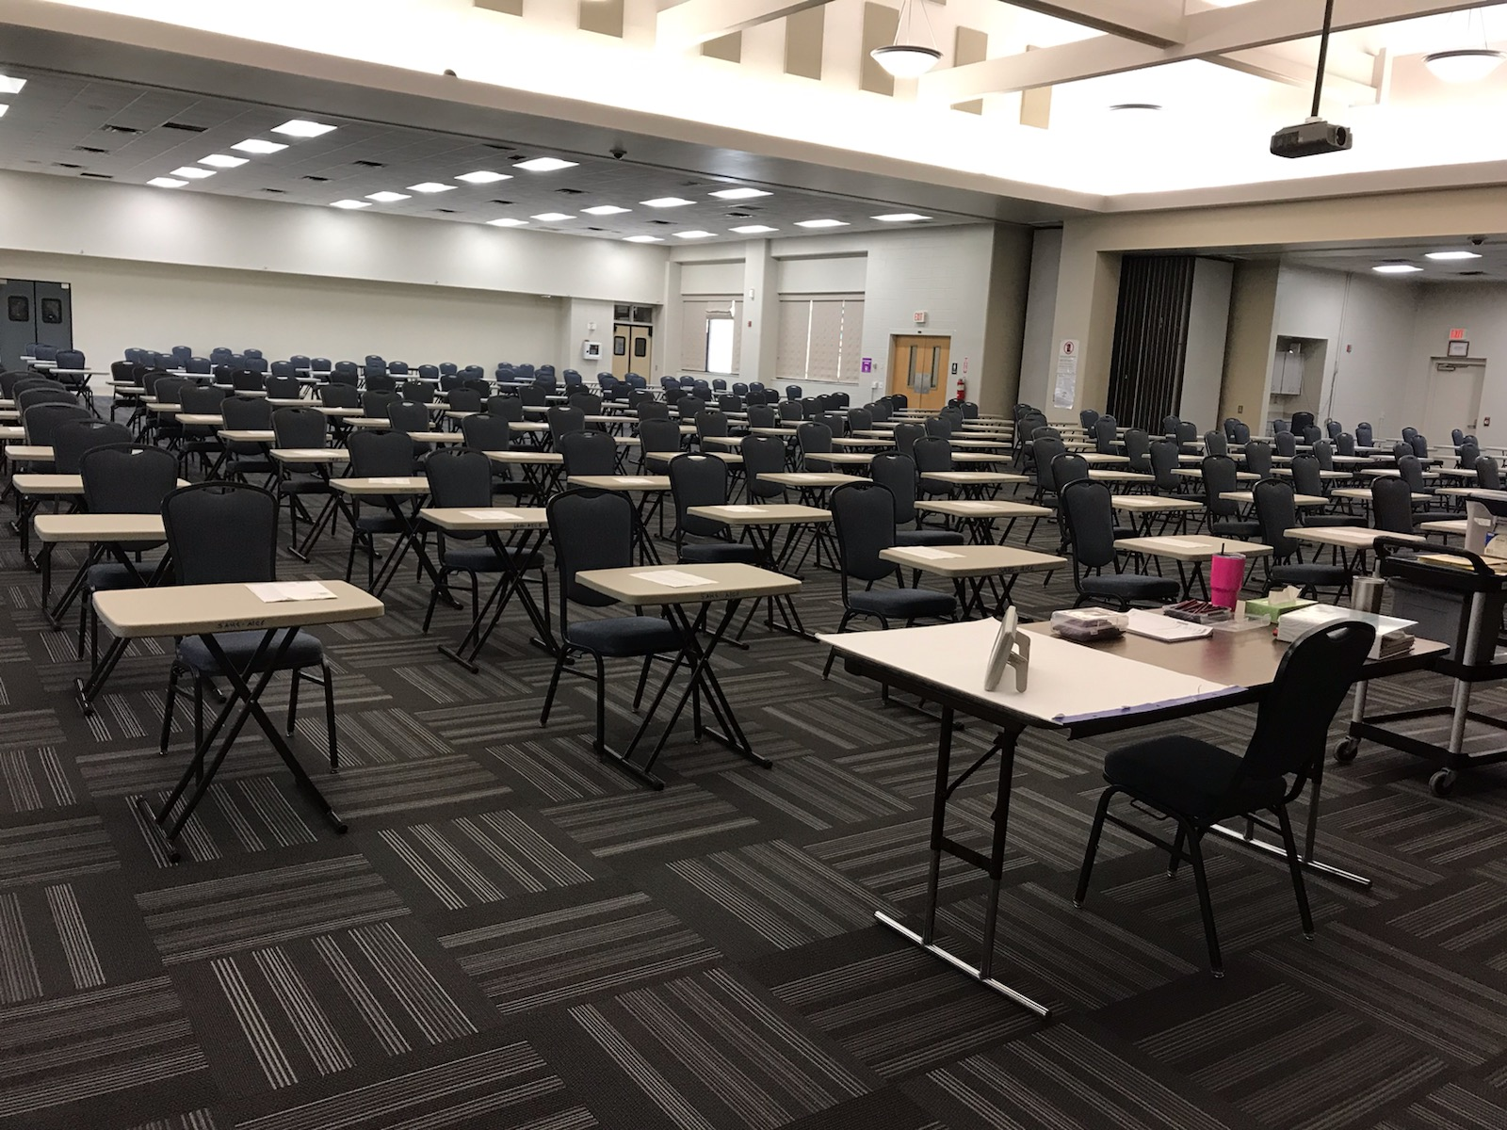
Exam Day!
ALL exams will be held at FCTC (Map in packet)
Bring a picture ID (jacket if needed)
Water in CLEAR containers only – no label.
Water bottles available in exam room
NO BACKPACS OR CELL PHONES ALLOWED IN THE CAMBRIDGE EXAMS! NO EXCEPTIONS!
Arrive at least 20 minutes prior to the published start time
Lunch??
Enter the exam room UNDER EXAM CONDITIONS

Slide 9
Exam Day!
KNOW YOUR SCHEDULE!
Follow signs behind SAHS to FCTC
Check-in procedures (how to find your desk, etc.)
Seated in CANDIDATE NUMBER order (not necessarily alpha)
STUDY! No doodling, profanity, etc.
Receive a pass at the end of the exam
Absence calls

Slide 10
Results??
Available in August 2023
Passing grade = ??
College Credit-by-Exam
ADIP
College admissions
Individual Login access provided in April
Certificates in October 2023
USE YOUR NEW AICE FOLDER!
All exam paperwork
Login access
Certificates

Slide 11
Questions about June 2023 Exam session?

Slide 12
AICE Curriculum vs. AICE Diploma Award (ADIP)

Slide 13
Cambridge A.I.C.E. Diploma Award
The A.I.C.E. Diploma Award is an internationally recognized AWARD for academic rigor
Must Pass seven (7) A/AS Level Exams
Minimum of 1 exam passed in each category
Automatically qualified for Florida Academic Bright Futures Scholarship
Must do 100 hours Community Service
GPA and ACT/SAT requirement waved

Slide 14
Graduation Requirements for the AICE Curriculum
AICE Curriculum
Complete* Seven A.I.C.E. level courses with at least one in each academic category
“Complete” means = *1. earn a passing grade, 2. “sit for” (take) the FULL exam
Academic Categories:
Language
Math/Science
Humanities
The “Core”
Optional Category – Interdisciplinary Studies

Slide 15
Graduation Requirements for the AICE Curriculum
AICE English required all 4 years
Global Perspectives required 11th grade year
AICE Curriculum Completers = Exempt from HOPE, Fine Arts, American Government, Economics & Online course
Must meet course progression requirements for university entry
(i.e. 4 (AICE) English, 2 World Language, 3 Science, 3 Social Studies, 4 Math)

Slide 16
Staying on the AICE Curriculum
See AICE Planning Sheet – Course Progression
Grades from 1st semester = course rec.’s for next year!!
Once in AICE = Always in AICE???
Flexible schedule for all students
AICE Students CAN take Dual Enrollment classes!
Course Requests = February (based on Teacher Rec’s!)

Slide 17
Course Registration for 2023-2024 School Year

Slide 18
Course Recommendations in HAC
Check recommendations in HAC soon
1st semester grades = next year’s course recommendations
For Junior year – MUST have AICE Eng. Lit 1, AICE Global Perspectives and most = AICE U.S. Hist.
Choose electives
Junior year – last year for GPA used for college admissions decisions!
Individual Registration meetings in Feb.

Slide 19
Course Recommendations in HAC
If you’re not recommended for AICE level courses
Talk to the teacher BEFORE your registration meeting
Decide if you want to continue in AICE (diff. grad. requirements)
Do what’s necessary for the teacher to change the recommendation
Use AICE Tutors, meet with teacher, utilize retakes, turn in all of your work!

Slide 20
Course Registration for 2023/2024 School Year
Freshman Year Schedule Sophomore Year Schedule
AICE English Language 1 (AS) AICE English Language 2 (AL)
AICE Geography AICE International History
Math Math
Algebra 1 Honors OR Algebra 2 Honors OR
Geometry Honors OR AICE Math OR
Algebra 2 Honors Pre-Calc. OR
Pre-AICE Biology Statistics Honors
Pre-AICE World Language 1 Pre-AICE Chemistry
(Spanish, French) Pre-AICE World Language 2
Academic Elective(s) Academic Elective(s)
Elective(s) Elective(s)

Slide 21
Course Registration for 2023/2024 School Year
Junior Year Schedule Senior Year Schedule
AICE English Literature 1 (AS) AICE English Literature 2 (AL)
AICE US History Math (AP Calc. AB, AP Calc. BC, AP Stat. DE College Alg./Pre-Calc
Math
Pre-Calc., Stat. Honors OR Science (AICE Physics, Bio, Chem.,
AICE Math OR Env. Mgt., Marine, P.E.)
AP Calc. AB OR AICE US History (if not taken in 11th)
AP Stat. AICE AL Global Perspectives
AICE Physics, Marine, Env. Mgt. AICE World Language
AICE Chemistry, Bio., P.E. Academic Elective(s)
AICE AS Global Perspectives Elective(s)
Pre-AICE World Language 3 (honors weighting)
Elective(s)

Slide 22
Subject Categories
Math & Science Languages Arts & Humanities
Math English Language English Literature AS
Marine Science (AS/AL) Spanish Language English Literature AL
Physics (AS/AL) US History
Chemistry (AS/AL) International History
*Environmental Management Music (AS/AL)
*Psychology (AS/AL) Drama (AS/AL)
*Physical Education (Sports Medicine) Economics (AS/AL)
Art & Design (AS/AL)
Core (required) Optional Interdisciplinary Cat. Dig. Media & Design (AS/AL)
Global Perspectives AS English General Paper Art & Design is offered in
Thinking Skills (AS/AL) Draw/Paint or Ceramics
Global Perspectives AL
*These courses count in either the Math/Science or Arts & Humanities categories

Slide 23
Questions about Course Registration?

Slide 24
What do I need to do as a Sophomore?
Get to know your teachers, counselor, and make connections.
Start thinking about what you want to do after graduation. This
will help drive your “path” through high school – which classes to
take, which activities to join, etc.
Get involved at school!
Join clubs, get leadership positions, play sports, community service, social events

Slide 25
College Information
Questions? See Ms. Eakins – College & Career Counselor (HIVE)
Start contacting/researching colleges this summer
Watch Facebook, IG, etc. and make sure everything is “clean”
NCAA – athletes, be familiar with process to assure eligibility. Go to NCAA Clearinghouse website.
Go on College Tours – starting NOW – FSU Tour Jan. 31st – forms in School Counseling office – TURN IN NO LATER THAN JAN. 20th!
Go to Virtual College Fairs!
PSAT as a Junior – for National Merit Scholarship program!
Notes:
Back to Tab 3 – see Year by Year checklist.

Slide 26
Where can I find Volunteer Opportunities?
Search online at www.volunteermatch.org
Pay attention to announcements for opportunities
Check with local organizations like food pantries, animal shelters, churches, elderly homes
Join clubs who provide volunteer opportunities like AICE Advisory Board! (and Key Club, Interact, Recycling Club)
Volunteer at AICE Events to be eligible for the AICE Scholarship!

Slide 27
AICE Events/Activities
AICE Advisory Board – weekly meetings
Fund raisers – emails, texts re: volunteering
Celebrity Scoop Night Fri., Feb. 10th!
AICE Game Day in April – sign up will be in Guidance
AICE Silent Auction – May
Volunteer by getting donations
Volunteer by helping to make phone calls
Volunteer on the night of the event

Slide 28
How to turn in Community Service Hours
Community Service Hours Form & Plan/Reflection Log
(always available in School Counseling office)
Turn in to your School Counselor when you have accrued 25+ hours
Letter from organization is REQUIRED for outside non-profit
On Letterhead
Name of Organization
Your Name
Activity & number of hours volunteered
Signature
Signature on Log if hours are done for a school related club/group – no letter
Complete Service Plan for each organization, submit to Ms. Moloney with log

Slide 29
AICE Swag
All Available in Ms. Bechtle’s office!
AICE Polo Shirts (required when volunteering for AICE events) - $15
AICE T-Shirts - $10
AICE Magnets - $7 each or 2/$10
AICE Stickers - $7 each or 2/$10

Slide 30
New T-Shirts & Hoodies

Slide 31
Don’t miss out on important Information and updates!
Pay attention to AICE & Jacket School Counseling Schoology Posts – enable notifications
Check out the School Counseling website
Follow @JacketSchoolCounseling on
Make an appointment online (SAHS website) or email Ms. Bechtle if you have questions.

Slide 32
QUESTIONS??

