Slide 1
AICE Seniors

Slide 2
NEWS YOU NEED!!
Online Appointment Request for School Counselor appointments
(SAHS website)
AICE Schoology & Yellow Jacket School Counseling – enable notifications
Follow @JacketSchoolCounseling on Instagram
Notes:
Post REMIND info., pass around Tutor Lists

Slide 3
June 2023 Exam Session Info.
Statement of Entry – WHITE (you keep this!)
Name, DOB, gender
Do the exams match your AICE courses?
Pay attention to “CARRY FORWARD”
Issues? Add them to the corrections list
Exam Schedule – YELLOW (you keep this!)
Find ALL of your Papers, highlight, put them in your phone, planner, etc.
Any conflicts?

Slide 4
June 2023 Exam Session Info.
Exam Letter – PINK (Complete & TURN THIS ONE IN!!!)
READ!!!
Have your parents READ it!
Student signature, parent signature – DUE TO MS. MOLONEY BY FRIDAY FEB. 3rd!!!
Add any re-takes (payment can be made later)
Exam Letter must be completed/turned in even if you’re NOT ordering anything!!
ADIP
If not earned in June or Nov. 2022
May have ADIP on SOE if eligible now
May need to retake something in order to be eligible
ADIP will NOT be added for you unless retakes/add’l exams needed to qualify are added to Exam Order/Retake form (Pink)

Slide 5
Exam Reminders
Students are required to sit for the Cambridge exam (ALL papers) in lieu of their final exam for each AICE course.
What does it mean to “sit for” a Cambridge exam?
What if you don’t show up for the Cambridge exam (or any part of it)?
Alternate final exam for that course, = new semester grade calculated.
“Owe” list for the exam fee ($110.10)– preventing you from buying prom tickets, getting your diploma, etc. until that amount is paid.
That AICE course cannot be counted towards graduation.
What if a Cambridge exam conflicts with a SAHS final exam?
Attend the Cambridge exam & go to the make-up exam time for your final.
The exam schedule is available via AICE teachers, on the AICE Website, and AICE Schoology or pick one up from Ms. Moloney if you lose yours!

Slide 6
Exam Reminders (cont’d)
No make-up days
Can’t change any of the dates/times
All morning exams = 8:45am; afternoon exams = 12:45pm. This is the START TIME for the exam
PLAN TO ARRIVE 20 MINUTES BEFORE START TIME!
Students MUST remain in the exam room for the entire exam time!!
Conflict Schedules - how do those work?
What if you’re sick?
What if you’re late?

Slide 7
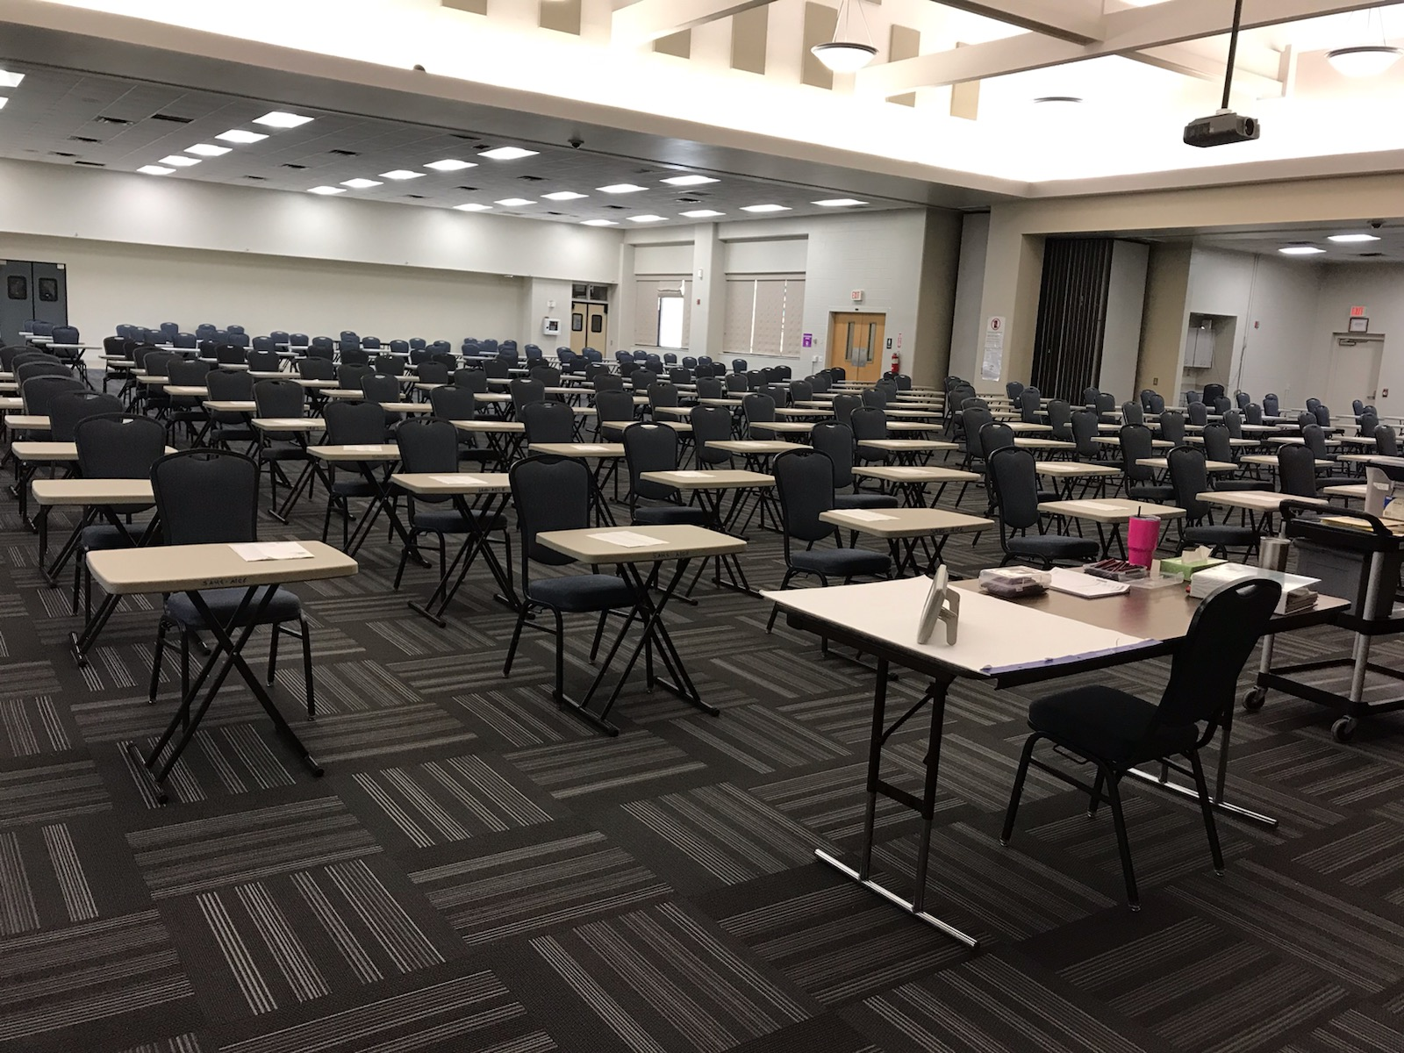
Exam Day!
ALL exams will be held at FCTC
Bring a picture ID (water bottle, jacket)
NO BACKPACS OR CELL PHONES ALLOWED IN THE CAMBRIDGE EXAMS! NO EXCEPTIONS!
Arrive at least 20 minutes prior to the published start time
Lunch??
Enter the exam room UNDER EXAM CONDITIONS

Slide 8
Exam Day!
KNOW YOUR SCHEDULE!
Follow signs behind SAHS to FCTC
Check-in procedures (how to find your desk, etc.)
Seated in CANDIDATE NUMBER order (not necessarily alpha)
STUDY! No doodling, profanity, etc.
Receive a pass at the end of the exam
Absence calls

Slide 9
Results??
Available in August 2023
Passing grade = ??
College Credit-by-Exam
ADIP
College admissions
Individual Login access provided in April
Certificates in October 2023
USE YOUR NEW AICE FOLDER!
All exam paperwork
Login access
Certificates

Slide 10
HOW DO I GET MY SCORES/CERTIFICATES??
Online access (all) – August 2023
Indiv. Login/passwords will be distributed in April/May 2023
DON’T LOSE IT!!
Self-addressed envelope for certificates
(arrive at SAHS in Oct. 2023)
Include email/phone if we are holding it at school
Electronic Transcript Request Form
How to address an envelope!
SAHS Return address
First Name Last Name
Street Address
City, State, Zip Code

Slide 11
Cambridge Electronic Transcript Request
Available on AICE Schoology & AICE Website
Use Transcript Request form AND Transcript Instructions
Two options:
Submit one request with ALL exam sessions listed, if requested AFTER March 1st
Or – request all exam sessions prior to June 2023 now, then submit another request after March 1st for the June 2023 results
Save the automated email reply with “Enquiry Number”
Another email when transcript is sent
SAVE YOUR CERTIFICATES – take them with you to college advising appt.

Slide 12
Communicating ADIP to your college
Current ADIP (earned in June 2022 or Nov. 2022)
ADIP info. is communicated to Bright Futures in Feb./March 2023
Bright Futures updates data base for June eval., money is available for summer
June 2023 ADIP Earners
Ask your college Financial Aid Office to “defer payment” for any balance owed before ADIP result is known/applied
You log in to Cambridge site in Aug. & see that you earned your ADIP – yay!!
Cambridge automatically communicates ADIP info. to Bright Futures in August
Bright Futures updates their data base
YOU need to let your college Financial Aid office know you now qualify for more money
Ask them to access the Bright Futures Update (they won’t do it unless they know they need to!)
The money is applied to your account

Slide 13
Questions about June 2022 Exam session?

Slide 14
AICE Curriculum vs. AICE Diploma Award (ADIP)

Slide 15
Graduation Requirements for the AICE Curriculum
AICE Curriculum
Complete* Seven A.I.C.E. level courses with at least one in each academic category
“Complete” means = *1. earn a passing grade, 2. “sit for” (take) the FULL exam
Academic Categories:
Language
Math/Science
Humanities
The “Core”
Optional Category – Interdisciplinary Studies

Slide 16
Cambridge A.I.C.E. Diploma Award
The A.I.C.E. Diploma Award is an internationally recognized AWARD for academic rigor
Must Pass seven (7) A/AS Level Exams
Minimum of 1 exam passed in each category
Automatically qualified for Florida Academic Bright Futures Scholarship
Must do 100 hours Community Service
GPA and ACT/SAT requirement waved

Slide 17
Subject Categories
Math & Science Languages Arts & Humanities
Math English Language English Literature AS
Marine Science (AS/AL) Spanish Language English Literature AL
Physics (AS/AL) US History
Chemistry (AS/AL) International History
*Environmental Management Music (AS/AL)
*Psychology (AS/AL) Drama (AS/AL)
*Physical Education (Sports Medicine) Economics (AS/AL)
Art & Design (AS/AL)
Core (required) Optional Interdisciplinary Cat. Dig. Media & Design (AS/AL)
Global Perspectives AS English General Paper Art & Design is offered in
Thinking Skills (AS/AL) Draw/Paint or Ceramics
Global Perspectives AL
*These courses count in either the Math/Science or Arts & Humanities categories

Slide 18
Senior Info!
Final HS Transcript – use Parchment (click option to “hold for grades”)
No Diploma in your Diploma Holder at graduation: available @ SAHS after last exam
#Accepted T-Shirts – see Ms. Eakins when you make your college decision!!
SJRSC Free Application Day – January 19th!
College Orientation – DON’T SCHEDULE ON EXAM DAY!
Still waiting on admissions decision? CLEAN UP FACEBOOK, etc.
Credit-by-exam – use search bar on college website
Notes:
Representatives from SJR State will be in the Media Center from 1st through 4th periods that day to help them fill out their applications, and the application fee will be waived. Students should check in to their class and then report to the Media Center during the period that they choose to attend. The application process will take the entire period.

Slide 19
More Seniors Info!
Complete FAFSA!
Complete Bright Futures!!
Turn in ALL Community Service Hours!
All ranks (Val., Sa., Magna, Suma, Cume) calculated after S1 grades
Complete Senior Survey online (part of senior check-out)
Senior Awards Night – TBA – May 2023
See Ms. Eakins – College and Career Counselor in the HIVE!

Slide 20
Money for College!
Scholarship applications – deadlines NOW
SAHS School Counseling website (Scholarship Bulletin) & District
Other HS websites
College websites (freshman scholarships – don’t have to wait for admissions decision to apply)
Fastweb
Collegeconfidential
Scholarshipexperts
Raise.me
Cappex
Chugg
Gocollege
Scholarshipamerica
GOOGLE Search

Slide 21
Community Service Hours
Search online at www.volunteermatch.org
Pay attention to announcements for opportunities
Check with local organizations like food pantries, animal shelters, churches, elderly homes
Join clubs who provide volunteer opportunities like AICE Advisory Board! (and Key Club, Interact, Recycling Club)
Turn in all hours BEFORE graduation!

Slide 22
How to turn in Community Service Hours
Community Service Hours Form & Plan/Reflection Log
(always available in School Counseling office)
Turn in to Ms. Moloney when you have accrued 25+ hours
Letter from organization is REQUIRED for outside non-profit
On Letterhead
Name of Organization
Your Name
Activity & number of hours volunteered
Signature
Signature on Log if hours are done for a school related club/group – no letter
Complete Service Plan (REQUIRED), submit with log

Slide 23
AICE Scholarship!
Volunteer at AICE Events
Essay
Teacher Recommendation
Minimum 3.0 unweighted GPA
Application will be available in Feb.

Slide 24
AICE Events/Activities
AICE Advisory Board – weekly meetings
Fund raisers – emails, Schoology messages re: volunteering
AICE Game Day in March – sign up will be in School Counseling Office
AICE Silent Auction – May
Volunteer by getting donations
Volunteer by helping to make phone calls
Volunteer on the night of the event

Slide 25
AICE Senior Events/Activities
Senior Awards Night – TBA
AICE Sash
Cords for Academies
Cords for Academic Award levels
Scholarships Announced/Awarded
AICE Senior Luncheon – May ?

Slide 26
AICE Swag
All Available in Ms. Bechtle’s office!
AICE Polo Shirts (required when volunteering for AICE events) - $15
AICE T-Shirts - $10
AICE Magnets - $7 each or 2/$10
AICE Stickers - $7 each or 2/$10

Slide 27
Don’t miss out on important Information and updates!
Check out the SAHS School Counseling & AICE websites
Follow @JacketSchoolCounseling on
Enable notifications from Schoology – AICE and Yellow Jacket School Counseling Office
Make an appointment online (SAHS Website) or email Ms. Bechtle with questions

Slide 28
QUESTIONS?

