Slide 1
Cambridge A.I.C.E. Advanced International Certificate of Education
St. Augustine High School
Welcome!

Slide 2
SAHS AICE Contacts
Dr. Graham, Principal
Ms. Michelle Davis, Assistant Principal
Ms. Bechtle, AICE School Counselor/Program Coordinator
Dawn Eakins, College & Career Counselor/Exams Officer

Slide 3
A.I.C.E. at St. Augustine High
St. Augustine High started the Cambridge A.I.C.E. program in 1997.
SAHS was the 2nd school in the US to begin an A.I.C.E. program.
Rigorous and Flexible Curriculum
33 AICE Level Courses
Writing based
Critical Thinking
Heavy analyzing, less memorization

Slide 4
What is A.I.C.E.?
Advanced International Certificate of Education
Advanced studies program affiliated with Cambridge International Examinations in the United Kingdom
C.I.E. is the largest program like this in the world with over 10,000 participating schools in over 160 countries
Students explore areas of strength and interest while taking college-level courses in HS
Rigorous, international curriculum that is heavily writing-based – strong emphasis on critical thinking, analysis, interpretation

Slide 5
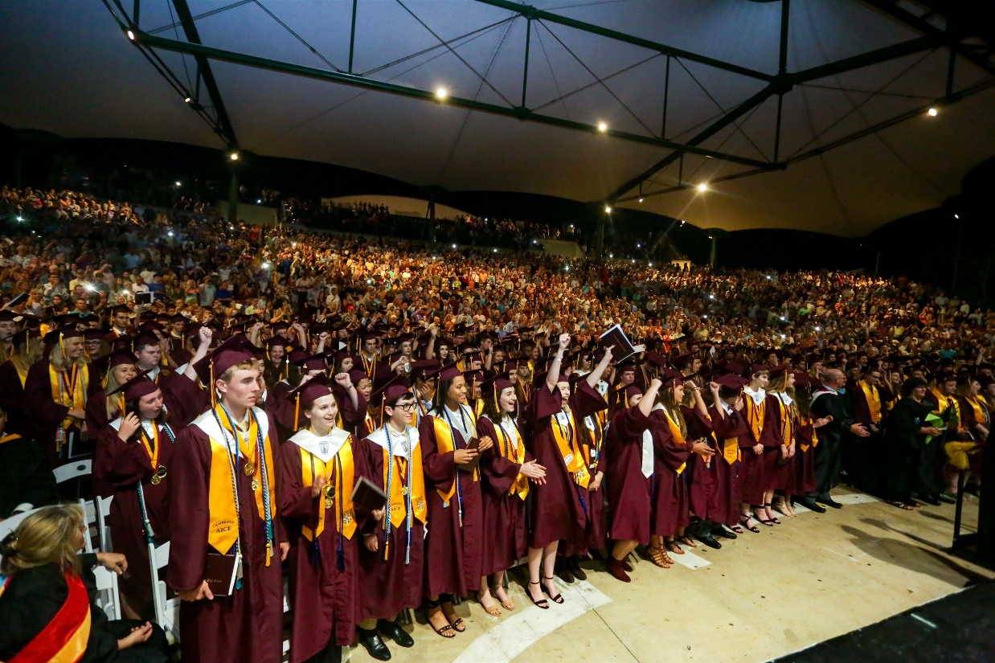
Why A.I.C.E.?
Flexible Curriculum
Future Predictor of College Success
FSU Study
GPA Points
College Credit
Bright Futures

Slide 6
FSU Study
AICE Students = 4-year graduation rate = 90%
Vs. 78% via no accelerated HS program
AICE students B.A. achieved = 3.8 years ave.
Cambridge students = higher grades
73% earned A’s, vs. 43% of control group
98% earned C’s or above vs. 91% control group
6 subjects studied – students who passed AICE Exams
50 – 81% AICE students earned A’s in subsequent courses
38 – 73% control group earned A’s (no AICE exams)

Slide 7
AICE Exam Results at SAHS 2022 Exam Session
Overall, SAHS AS pass rate = 83.7%
Increase from June 2019 – 65% (19% increase!)
Statewide increase = 8%
Nat’l overall pass rate = 78%
ADIP’s earned
74 (89%) in 2020
97 (92%) in 2021
125 (95%) in 2022
Notes:
Nat’l ADIP pass rates were not provided

Slide 8
Successful AICE Applicant
FSA Reading = level 4 or above (3 minimum)
Alg. 1 completed (preferred, not required)
A/B student, advanced level MS courses
Highly motivated for academic success
Positive Teacher Recommendations
Dedicated to studies – keep up with HW
Organized – handling rigor & extra-curricular
Willing to communicate with teachers - ask for help!

Slide 9
Application Process
Apply on HAC account through January 31st, 2023
https://cte.stjohns.k12.fl.us/ for more info.
Teacher recommendations sent to Mrs. Bechtle (one each from the current English, Math, Science, Social Studies teacher)
Private School/Home School Applicants only:
Must apply via the PowerSchool Online Registration link: https://www.stjohns.k12.fl.us/student/enrollment/
or call the CTE Department (547-4870).
Submit most recent report card & any standardized testing results to Ms. Bechtle (via postal service or email)
Everything should be received here at SAHS by the end of the day on January 31st, 2023
Notification in Feb. 2023

Slide 10
Out-of-Zone Applicants
Cannot select AICE at SAHS if your zoned school has IB or AICE
Choose SAHS Academy(s) as 1st (& 2^{nd)} choice (lottery based)
Can select IB or AICE for 2nd or 3rd choice if offered by your zoned school, and you have an interest
Distribute Teacher Rec. forms for AICE now
This is how we know your student is interested in AICE at SAHS
We will review academy acceptances first – then AICE decisions
AICE decisions will be emailed (by Ms. Bechtle vs. HAC notification)

Slide 11
The A.I.C.E. Program Student
Expectations

Slide 12
Expectations in AICE
DO
DON’T
Expect to struggle! (If you’re not challenged, you’re not growing!!)
Remain Organized
Keep up with your work
Ask teachers for help
Use outside tutors
Reach out to friends
Try different solutions/study methods
Dismiss a low grade
Focus on the exam results
Get discouraged with a low grade – figure it out!
Try to “fix” the problem yourself
Engage in harmful attitudes or blaming others
Blame the “teaching style”
DON’T Give Up!

Slide 13
9th Grade Schedule
AICE English General Paper*
Biology 1 Honors
Pre-AICE Global Perspectives
Geometry, Algebra 2 Honors, AICE Math
Pre-AICE Language 1 (or 2)
Elective (or Academy Course)
Elective (or Academy Course)
*College Level Class*

Slide 14
The AICE Student at SAHS:
Participates in multiple areas of interest
Multiple academies – very common!
Participates in service projects
Specific AICE Program Activities
The most highly-trained teachers in the school
Dedicated AICE School Counselor

Slide 15
A.I.C.E. Curriculum Requirements VS. Cambridge A.I.C.E. Diploma Award
What’s the Difference?

Slide 16
Graduation Requirements for the A.I.C.E. Curriculum
AICE Curriculum
COMPLETE* Seven A.I.C.E. level courses with at least one in each academic category
“Complete” means = *1. earn a passing grade in the course and
2. “sit for” (take) the FULL Cambridge exam at the end of the course. *1. earn a passing grade, 2. “sit for” (take) the FULL exam
Academic Categories:
Language
Math/Science
Humanities
The “Core”
Optional Category – Interdisciplinary Studies

Slide 17
Course Options
AICE English (all 4 years)
AICE Global Perspectives (11th grade)
Options for subject categories
AICE Students CAN take DE Courses

Slide 18
Graduation Requirements for the A.I.C.E. Curriculum
AICE English required all 4 years
Global Perspectives required 11th grade year
AICE Curriculum Completers = Exempt from HOPE, Fine Arts, American Government, Economics & Online course
PASSING AICE Exams is NOT required for graduation!
Must meet course progression requirements for university entry
(i.e., 4 (AICE) English, 2 World Language, 3 Science, 3 Social Studies, 4 Math)

Slide 19
Cambridge A.I.C.E. Diploma Award
The A.I.C.E. Diploma Award (ADIP) is an internationally recognized AWARD for academic rigor
Must Pass seven (7) A/AS Level Exams
Pass at least 1 exam in each category (grade of “a” – “e”)
25-month time period for award calculation
Automatically qualified for Florida Academic Bright Futures Scholarship (top level)
Must have 100 hours Community Service logged
GPA and ACT/SAT requirement waived

Slide 20
Exam Sessions/Options
June Exam Session: Cambridge Exam after course
Multiple “Papers” per subject, not just one exam
November Exam Session = retakes
Exam Schedule – WILL go into June each year!!!
AM exams START at 8:45am, no bus those days!

Slide 21
Bright Futures
Florida Scholar Award (FSA - top level)
Pays 100% of tuition
ADIP Earners
SAT/ACT Score requirement waived
GPA requirement waived
Community Service Hours – NEW procedures
100 Hours for FSA
Volunteer or work hours can be used!

Slide 22
AICE Exams in College
Admissions advantage for success in AICE program/courses
Each exam passed = college credit earned
ALL FL Public Colleges accept/award college credit for passing scores on AICE Exams

Slide 23
AICE Exams in College
Private/out-of-state colleges will have their own policy about credit-by-exam (AICE, IB, and DE) – check websites.
Over 850 colleges/universities have Cambridge exam policies
Taking (& doing well in) the COURSES = admissions advantage - gets you in the door!
Cambridge Electronic Transcript Request = submit in March of senior year.

Slide 24
In a Nutshell
FLEXIBLE
Explore Multiple Interests in HS
College Admissions Advantage
Head start on College Credits
Skills for College Success

Slide 25
Handouts
AICE Course Progression
AICE Fact Sheet
AICE Brochure
Teacher Recommendation forms

Slide 26
Contact Information
Dena Bechtle
904-547-8533, Dena.Bechtle@stjohns.k12.fl.us
Dawn Eakins
904-547-2013, Dawn.Eakins@stjohns.k12.fl.us
Michelle Davis
904-547-8513, Michelle.Davis@stjohns.k12.fl.us
Dr. Graham
904-547-8510, DeArmas.Graham@stjohns.k12.fl.us

Slide 27
Questions?? In the Lobby – Ms. Bechtle & AICE students

