Slide 1

Cambridge A.I.C.E.
Advanced International Certificate of Education
St. Augustine High School
Welcome!

Slide 2
Introductions
Dr. Graham, Principal
Ms. Michelle Davis, Assistant Principal
Ms. Jill Lee, Assistant Principal
Mr. Trevor Abbs, Assistant Principal
Ms. Bechtle, AICE School Counselor/Program Coordinator
Ms. Christine Moloney, AICE Clerk/Exams Officer
Dawn Eakins, College & Career Counselor
AICE/Pre-AICE Teachers

Slide 3
A.I.C.E. at St. Augustine High
St. Augustine High started the Cambridge A.I.C.E. program in 1997.
SAHS was the 2nd school in the US to begin an A.I.C.E. program.
Rigorous and Flexible Curriculum
  Writing based
  Critical Thinking

Slide 4
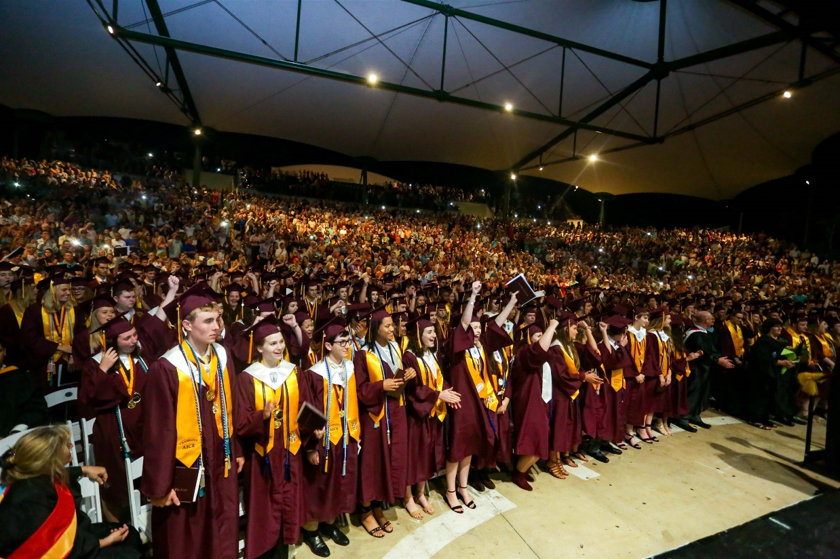
Why A.I.C.E.?
Flexible Curriculum
Future Predictor of College Success
  FSU Study
GPA Points
College Credit
Bright Futures

Slide 5
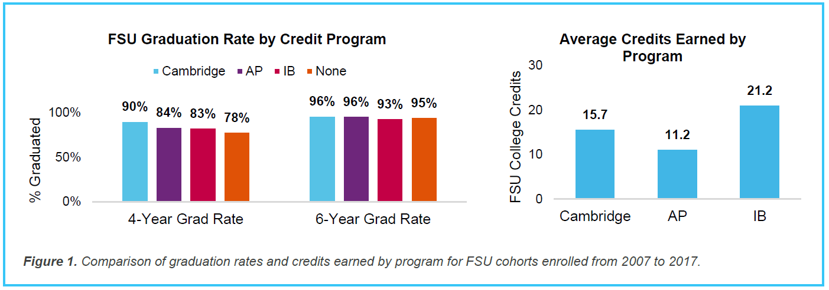
FSU Study – Grad. Rates
Notes:
Graduation data show that 90 percent of Cambridge students enrolled at FSU graduate within 4 years. The 4-year graduation rate for Cambridge students is much higher than students who enrolled at FSU with no credit via advanced high school programs (90 percent versus 78 percent). Cambridge students completed their bachelor’s degrees in an average of 3.8 years.
Moreover, a higher percentage of Cambridge students completed their bachelor’s degrees in four years compared to peers who earned college credit via other advanced coursework programs. This result is particularly impressive when comparing the number of FSU credits students receive from their high school advanced courses: a higher percentage of Cambridge students are graduating on time compared to peers who receive a comparable amount of credits from other programs.

Slide 6
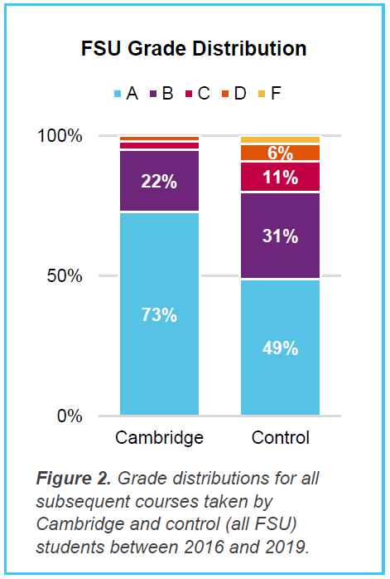
FSU Study – Grade Distribution
Notes:
Overall, 98 percent of grades achieved by Cambridge students in their subsequent FSU courses were passing grades (above a C or 2.0 GPA) compared to 91 percent for the total cohort of students.
Cambridge students tended to achieve higher grades: 73 percent of Cambridge students receiving college credit achieved an A in their subsequent course while 49 percent of the control (all students) earned an A.
Preliminary analyses suggest that students who score an E on their A or AS Levels continue to do well in college. Approximately 92 percent of students who scored an E on their A/AS Level went on to achieve an A or B grade in the relevant subsequent course in college. This result suggests that students scoring the minimum A/AS Level grade (E) still perform extremely well in their subsequent college courses.

Slide 7
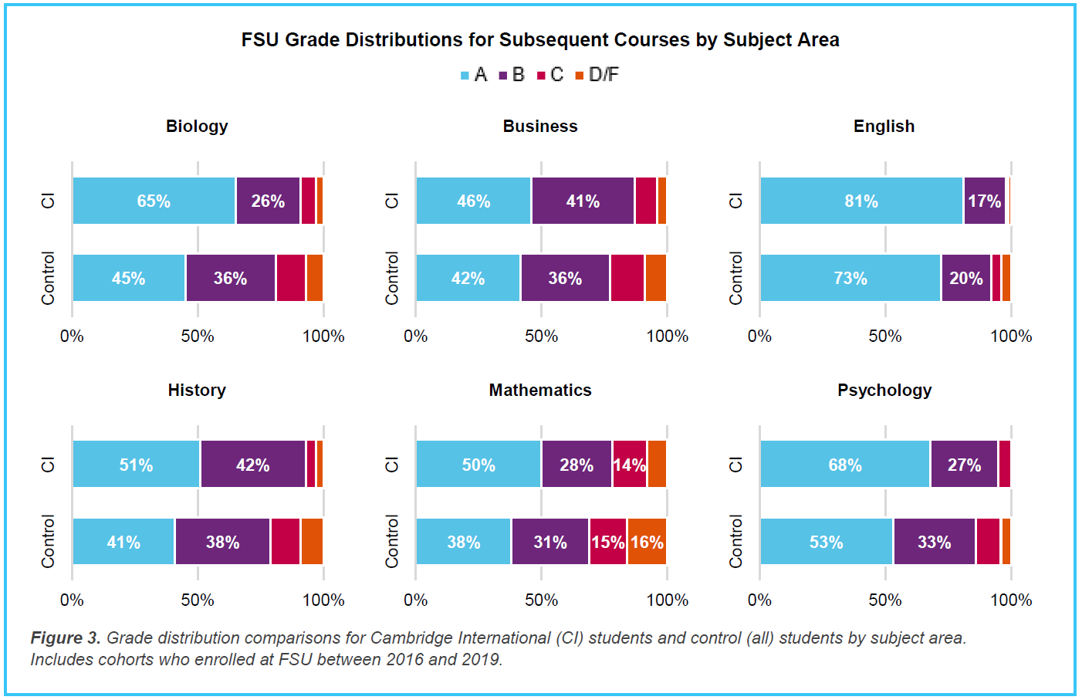
College Grades Earned
Notes:
In six subject areas (Biology, Business, English, History, Math, and Psychology), Cambridge students again performed well and followed a pattern of high achievement, with a higher proportion of Cambridge students achieving A grades in all 6 subject areas compared to the control group (all students). For example, Cambridge students achieved an A grade in 65 percent of the subsequent Biology courses compared to 45 percent for the control. This again suggests that students who received credit for their Cambridge International AS and A Levels are well prepared for high achievement in their subsequent college courses.

Slide 8
AICE Exam Results at SAHS
2021 Exam Session vs. 2019
Overall SAHS AS pass rate increase of 19%
  From 65% to 83.7%
  State ave. went up 8%
Overall SAHS AL pass rate increase of 15%
  From 86.7% to 92.7%
  State ave. went up 13%
119 ADIP’s earned in 2021, an increase of 77%
  67 in 2019
  92 in 2020
Notes:
Nat’l ADIP pass rates were not provided

Slide 9
Subject Pass Rate Comparison
18 AS Level Subjects
  67% of subjects = higher pass rate than National
  Of those 18, 3 were being tested in person for the 1st time
10 AL Subjects
  80% of subjects = higher pass rate than National
  Of those 10, one was being tested @ SAHS for the 1st time (AL Math 100% pass rate vs. 76.8 Nat’l)
Highest pass rate improvement from 2019 = 88% improvement for AS Physics!!
Notes:
6 AS Subjects did not beat the nat’l pass rate – 3 of those were being tested in person for the 1st time at SAHS (Drama, Music, PE)
Only 5 students took the AL Math – but all passed!

Slide 10
Expectations in AICE
DO
DON’T
Expect to struggle! (If you’re not challenged, you’re not growing!!)
Remain Organized
Keep up with your work
Ask teachers for help
Use outside tutors
Reach out to friends
Try different solutions/study methods
Dismiss a low grade
Focus on the exam results
Get discouraged with a low grade – figure it out!
Try to “fix” the problem yourself
Engage in harmful attitudes or blaming others
Blame the “teaching style”
DON’T Give Up!

Slide 11
What do I need to graduate from High School?
Standard Graduation Path:
  3 basic requirements:
    Earn 24 Credits
    Earn a 2.0 GPA
    Pass 2 state assessments (tests)

Slide 12
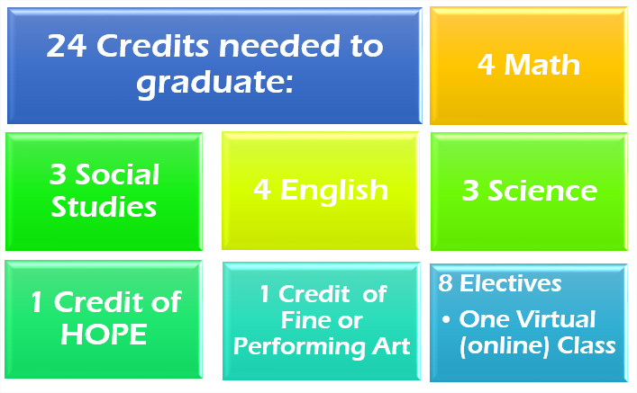
Standard (Non-AICE)
Graduation Requirements
Notes:
AICE Curriculum requirements/differences will be covered later...

Slide 13
Pass Two Tests
10th Grade ELA (English Language Arts) FSA
Algebra I EOC (End of Course Exam)

Slide 14
A.I.C.E. Curriculum Requirements
VS.
Cambridge A.I.C.E. Diploma Award
What’s the Difference?

Slide 15
Graduation Requirements for the
A.I.C.E. Curriculum
AICE Curriculum
  COMPLETE* Seven A.I.C.E. level courses with at least one in each academic category
    “Complete” means = *1. earn a passing grade in the course and
    2. “sit for” (take) the FULL Cambridge exam at the end of the course. *1. earn a passing grade, 2. “sit for” (take) the FULL exam
  Academic Categories:
    Language
    Math/Science
    Humanities
    The “Core”
    Optional Category – Interdisciplinary Studies

Slide 16
Subject Categories
Math & Science Languages Arts & Humanities
Math English Language AS English Literature AS
Marine Science English Language AL English Literature AL
Physics (AS/AL) Spanish Language US History
Chemistry (ASAL) International History
*Environmental Management European Hist. (AL)
*Psychology (AS/AL) Economics
Physical Education **Art & Design (AS/AL)
Dig. Media & Design (AS/AL)
Music (AS/AL)
Drama
Core (required) Optional Interdisciplinary Cat.
Global Perspectives General Paper Thinking Skills **Art & Design is offered in
Global Perspectives AL Draw/Paint or Ceramics

Slide 17
Graduation Requirements for the
A.I.C.E. Curriculum
  AICE English required all 4 years
  Global Perspectives required 11th grade year
  AICE Curriculum Completers = Exempt from HOPE, Fine Arts, American Government, Economics & Online course
  PASSING AICE Exams is NOT required for graduation!
  Must meet course progression requirements for university entry
    (i.e. 4 (AICE) English, 2 World Language, 3 Science, 3 Social Studies, 4 Math)

Slide 18
Cambridge A.I.C.E. Diploma Award
  The A.I.C.E. Diploma Award (ADIP) is an internationally recognized AWARD for academic rigor
Must Pass seven (7) A/AS Level Exams
  Pass at least 1 exam in each category
  25 month time period for award calculation
Automatically qualified for Florida Academic Bright Futures Scholarship (top level)
  Must have 100 hours Community Service logged, 2 yrs. Foreign Lang.
  GPA and ACT/SAT requirement waived

Slide 19
Bright Futures
Florida Scholar Award (FSA - top level)
  Pays 100% of tuition
  Pays $300/semester for books/expenses
ADIP Earners
  SAT/ACT Score requirement waived
  GPA requirement waived
Foreign Language
  Two years of foreign language (need 2nd year or higher)
Community Service Hours – NEW procedures
  100 Hours for FSA
  Use Community Service form, Plan & Reflection Log
  Non-Profit organizations only

Slide 20
Exam Sessions/Options
June Exam Session: Cambridge Exam after course
November Exam Session = retakes, some ADIP if eligible
A Level = 2nd year of a subject, “Carry Forward”, or re-take all
Teachers have June Results
  Students will receive indiv. Login/password info.
25 month timeframe for ADIP
Preliminary June 2022 Exam Schedule – last date June 10th

Slide 21
AICE Exams in College
Exam scores may NOT be required during admissions application process
Each exam passed = college credit earned
ALL FL Public Colleges accept/award college credit for passing scores on AICE Exams
Private and out-of-state colleges will have their own policy about credit-by-exam, DE – CHECK!!
Taking (& doing well in) the COURSES = admissions advantage - gets you in the door!
Cambridge Electronic Transcript Request = submit in Feb./March of senior year, after decision is made!

Slide 22
In a Nutshell
FLEXIBLE
Explore Multiple Interests in HS
College Admissions Advantage
Head start on College Credits
Skills for College Success

Slide 23
What’s Happening in A.I.C.E.?
AICE Advisory Board – Club for AICE students/parents. Meets Thurs. 8:30am E503
  College Tours (?)
  Fund Raisers
  Community Service
  AICE Game Day
  Student inspired activities
AICE Booster Club – Supporting AICE Students
  Monthly meetings
  Organize Fund Raisers
  Promote AICE
  Provide support materials, funding for events, “Angel Fund”
AICE Website
AICE Schoology Group – All AICE Students are part of this group
  Student Access Code: 9N4FH-GTRFQ

Slide 24
Parent Accounts: HAC & Schoology
Schoology:
  https://www.stjohns.k12.fl.us/media/edtech/schoology/schoology-for-parents/
HAC:
  https://www.stjohns.k12.fl.us/hac/

Slide 25
Handouts Available in AICE Schoology page - AICE Parent Night Resources Folder
AICE Course Progression
AICE Fact Sheet
AICE Brochure
FSU/Cambridge Study
Bright Futures new info./forms
AICE Booster Club Information
This PowerPoint presentation

Slide 26
Contact Information
Dena Bechtle
  904-547-8533, Dena.Bechtle@stjohns.k12.fl.us
Christine Moloney
  904-547-8523, Christine.Moloney@stjohns.k12.fl.us
Dawn Eakins
  904-547-2013, Dawn.Eakins@stjohns.k12.fl.us
Michelle Davis
  904-547-8513, Michelle.Davis@stjohns.k12.fl.us
Jill Lee
  904-547-8844, Jill.Lee@stjohns.k12.fl.us
Trevor Abbs
  904-547-8847, Trevor.Abbs@stjohns.k12.fl.us
Dr. Graham
  904-547-8510, DeArmas.Graham@stjohns.k12.fl.us

Slide 27
Questions?
Ms. Bechtle, Ms. Moloney – AICE Program, ADIP, etc.
AICE Student Volunteers – “real life” AICE
Ms. Eakins – Dual Enrollment, college applications, FAFSA
Ms. Davis – Curriculum, etc.

