Slide 1
Cambridge A.I.C.E. Advanced International Certificate of Education
St. Augustine High School
Welcome!
Ms. Bechtle, AICE Guidance Counselor
Dr. Graham, Principal
Ms. Michelle Davis, Assistant Principal
Ms. Jill Lee, Assistant Principal
Ms. Gail Godzich, AICE Coordinator

Slide 2
A.I.C.E. at St. Augustine High
St. Augustine High started the Cambridge A.I.C.E. program in 1997.
SAHS was the 2nd school in the US to begin an A.I.C.E. program.
Rigorous and Flexible Curriculum
Writing based
Critical Thinking

Slide 3
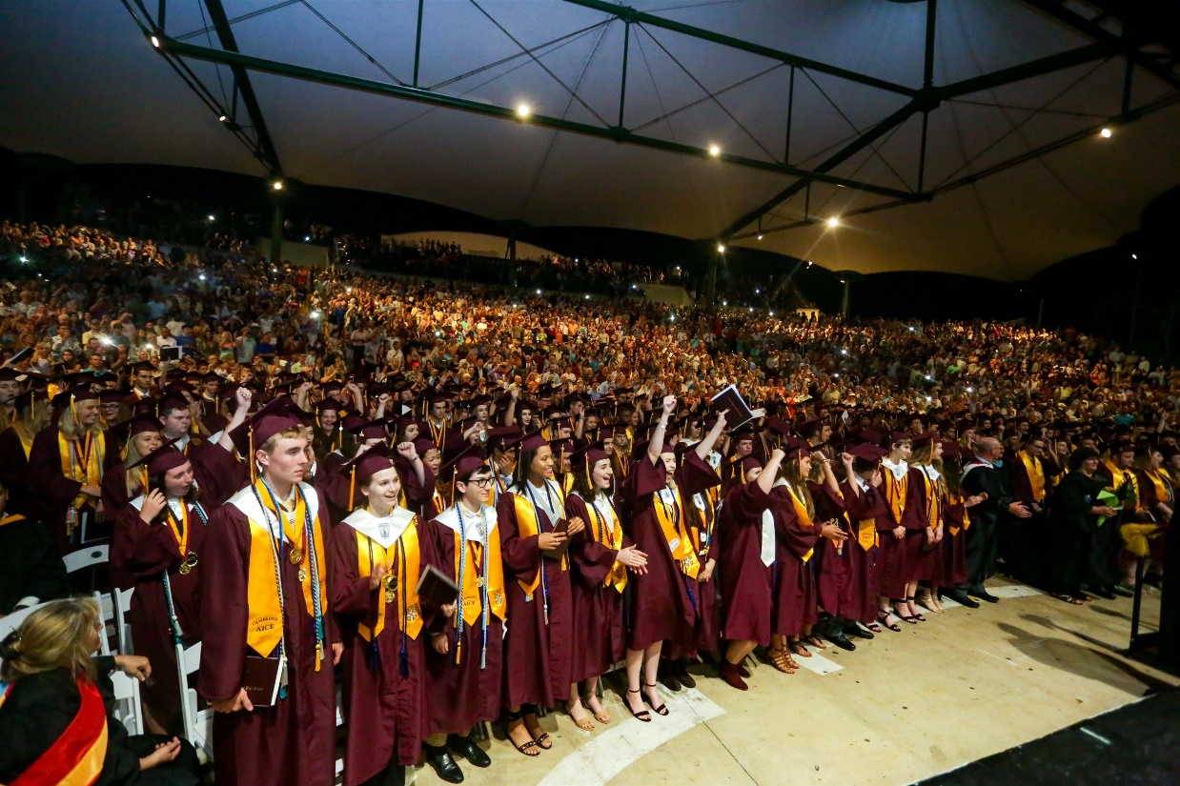
Why A.I.C.E.?
Flexible Curriculum
Future Predictor of College Success
FSU Study
GPA Points
College Credit
Bright Futures

Slide 4
A.I.C.E. Curriculum Requirements VS. Cambridge A.I.C.E. Diploma Award
What’s the Difference?

Slide 5
Expectations in AICE
DO
DON’T
Expect to struggle! (If you’re not challenged, you’re not growing!!)
Remain Organized
Keep up with your work
Ask teachers for help
Use outside tutors
Reach out to friends
Try different solutions/study methods
Dismiss a low grade
Focus on the exam results
Get discouraged with a low grade – figure it out!
Try to “fix” the problem yourself
Engage in harmful attitudes or blaming others
Blame the “teaching style”
DON’T Give Up!

Slide 6
A.I.C.E. Curriculum Requirements
Completing the Curriculum Defines
Graduation Requirements for A.I.C.E. Students
Economics, HOPE, Fine Arts & Online course not required
AICE Curriculum
Complete* Seven A.I.C.E. level courses in the four categories(*1. earn a passing grade, 2. “sit for” the exam)
AICE English required all 4 years
Global Perspectives required 11th grade year
Must meet course progression requirements for university entry within the SAHS A.I.C.E. Program (i.e. 4 years AICE English, 2 years World Language, 3 years Science, 3 Social Studies, 4 Math)
GPA requirement waved for Bright Futures if you complete

Slide 7
Cambridge A.I.C.E. Diploma Award
The A.I.C.E. Diploma Award is an internationally recognized AWARD for academic rigor
Must Pass seven (7) A/AS Level Exams
Minimum of 1 exam passed in each category
25 month time period for award calculation
Automatically qualified for Florida Academic Bright Futures Scholarship
Must do 100 hours Community Service
GPA and ACT/SAT requirement waved

Slide 8
Subject Categories
Math & Science Languages Arts & Humanities
Biology X English Language AS English Literature AS
Math C English Language AL English Literature AL
Physics (AS/AL) Spanish Language US History
Chemistry (ASAL) French Language C International History
*Environmental Management European Hist. (AL)
*Psychology (AS/AL) X Geography
Marine Science *Psychology (AS/AL)
Physical Education Art & Design (AS/AL)
Dig. Media & Design
Core (required) Optional Interdisciplinary Cat. Global Perspectives General Paper Thinking Skills
Global Perspectives AL

Slide 9
Exam Sessions/Options
Cambridge Exam after course = June exam series
A Level = 2nd year of a subject, “Carry Forward”, or re-take all
Teachers have June Component Results
November Series = retakes, some ADIP if eligible
25 month timeframe for ADIP

Slide 10
AICE Exams in College
Exam scores are NOT reported during admissions application process
Each exam passed = college credit earned
ALL FL Public Colleges accept/award college credit for passing scores on AICE Exams
Private and out-of-state colleges will have their own policy about credit-by-exam, DE – CHECK!!
Taking (& doing well in) the COURSES = admissions advantage - gets you in the door!
Cambridge Electronic Transcript Request = submit in Feb./March of senior year, after decision is made!

Slide 11
AICE Course Offerings
See AICE Planning Sheet
Select AP courses also available
Flexible schedule for all students
See Ms. Bechtle to develop your individualized plan.

Slide 12
In a Nutshell
FLEXIBLE
Explore Multiple Interests in HS
College Admissions Advantage
Head start on College Credits
Skills for College Success

Slide 13
What’s Happening in A.I.C.E.?
AICE Advisory Board – Club for AICE students/parents. Meets Thurs. 8:30am C302
College Tours
Fund Raisers
Community Service
AICE Game Day
Student inspired activities
AICE Booster Club – Supporting AICE Students
Monthly meetings
Organize Fund Raisers
Promote AICE
Provide support materials, funding for events, “Angel Fund”
“Like” the St. Augustine HS AICE Booster Club Facebook Page!
AICE Website
AICE Remind.com - Text Message system, Text @sahsaice to 81010

Slide 14
Handouts Available in Lobby
Course Progressions by grade level
AICE Fact Sheet
AICE Brochure
Articles re: College admissions
AICE Booster Club Information
REMIND.com instructions

Slide 15
Contact Information
Dena Bechtle
904-547-8533, Dena.Bechtle@stjohns.k12.fl.us
Gail Godzich
904-547-8523, Gail.Godzich@stjohns.k12.fl.us
Michelle Davis
904-547-8513, Michelle.Davis@stjohns.k12.fl.us
Jill Lee
904-547-8844, Jill.Lee@stjohns.k12.fl.us
Dr. Graham
904-547-8510, DeArmas.Graham@stjohns.k12.fl.us

Slide 16
Questions??

