Slide 1
SAHS Class Assembly
2019-2020

Slide 2
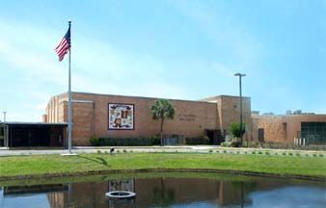
Welcome to SAHS
Deans Arnow, Cortes & Wallner

Slide 3
DEANS
Deans Cortes & Wallner – back/bottom hall (B268)
Mrs. Bost – Deans’ Secretary
dress code, lockers
(early check-outs & absence notes go to front office)
Dean Arnow – main/front hall (G 620)
Tardy & Skipping referrals, truancy, ASSIST
ISS is located in E Hall, Room 508

Slide 4
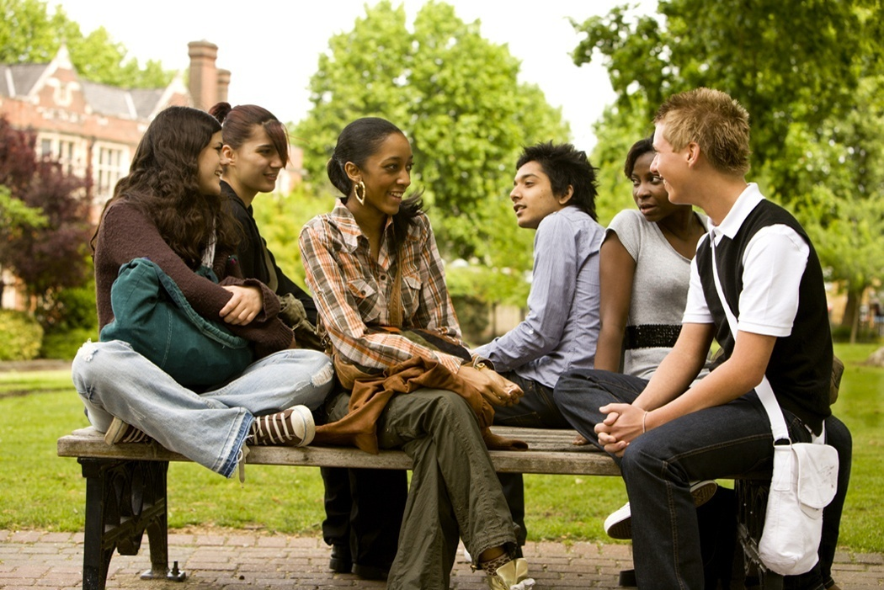
DRESS CODE

Slide 5
DRESS CODE
SAHS Student Planner
Students who are out of dress code must report to Mrs. Bost in the back hall Deans’ Office
Call home for change of clothing
Alternate clothing may be provided
If student can not get into dress code, student must spend the day in ISS
Progressive discipline applies

Slide 6
Dress Code-Key Points
Please refer to Dress Code Section in your Student Planners
Item #02: Hats/Hoodies/Bandanas/Bonnets/ Durags Not allowed
Item #05: 4-inch rule
Item #06: Tops
NO: tanktops, off the shoulder, spaghetti straps, halters
NO midriff exposed, low cut, see through, tank tops
Item #07: Pants (waist level, tears)
Proper fitting
Leggings must have full coverage
Pants/Jeans: Worn at waist level: no exposed undergarments

Slide 7
Code of Conduct
Drugs / Alcohol
Level 4 violation
Gaines Referral / EPIC Program
Vape / Tobacco
Level 3 violation
2 days OSS
Impact on athletic participation
Impact on attending after school events / activities

Slide 8
Electronic Devices
Cell phones
Before 1st period begins
After 7th period ends
In between classes
voice calls
taking pictures/videos
Headphones
Before 1st period begins
After 7th period ends
Hallways: one in/one out
During lunch/breakfast in the cafeteria and/or courtyard

Slide 9
Electronic Devices Continued
Bluetooth Speakers – NEVER
Classroom
Each teacher will inform you of his/her cell phone policy which applies to his/her classroom only. Ask them for clarification if you are not 100% clear EACH AND EVERY DAY.
** Failure to surrender device upon request **
=
SIGNIFICANT CONSEQUENCES

Slide 10
Academic Integrity
Cheating (Cheat Sheets, “Looking-On”)
Plagiarism
Altering Grades
Sharing information electronically
Review pg. 14 of Student Planner
“Lending”/Copying Homework
Review Student Code of Conduct
Level 2

Slide 11
Bullying & Harassment
Must include all three components:
Repeated
Intentional (done on purpose with the intent to cause hurt or harm)
Imbalance of power (you feel like you cannot make it stop)
Our school district policy defines bullying as systematically and chronically inflicting physical hurt or psychological distress.

Slide 12
LUNCH
Two choices: 1. Cafeteria or 2. Courtyard
Please clean up after yourself
No skipping or saving spots in line
Once at your seat, please remain seated
Proper Facing
Loud or disruptive behaviors are not acceptable
Use the restrooms at the bottom of C Hall

Slide 13
FOOD AND BEVERAGES
All food and beverages, with the exception of water, shall be consumed inside the cafeteria or courtyard areas only.
No food/snack/ drinks in the hallways.
Deliveries are prohibited (exception: lunch $)
NO outside food/drinks Ex: Dunkin cups etc…
No Seal, No Deal= yeti’s/mugs OK

Slide 14
Student Parking
Parking Decals must be visible hanging from rear view mirror
When arriving at gate, have your student ID ready
When exiting at the end of the day, turn left on Varella Rd.
If leaving campus during school:
Have student ID and check out slip
Be patient waiting for the gate to be unlocked
Parking/Attendance/ behavior infractions can result in 45 day decal/parking suspension
Parking violations could result in ASD, ISS, and towing your vehicle at your own cost
Student Code of Conduct applies to school parking lots
If you have a modified schedule go to the Dean’s office with your decal to obtain a colored identification mark.

Slide 15
LOCKERS
If you need a locker you must visit the Dean’s Office.
All lockers are assigned.
If you place a lock on a locker not assigned to you it will be cut off.
They are still considered school property.
You must have a combination lock.

Slide 16
CHECK OUT PROCEDURES
In order to check out early, you must present a note from your parent/guardian to the Front Office at the start of the day.
Students must sign out through the Front Office.
Students may only leave campus with their designated parent/guardian or person authorized on the emergency contact card.
Students who are ill must check out through the Clinic.
No check outs after 6th period.

Slide 17
TRANSPORTATION
Only bus riders report to the bus loop upon dismissal
Board your assigned bus as soon as it arrives
Get off at your assigned stop
Stay on the sidewalk while waiting for your bus
Walkers exit the school at the main entrance. If you walk off school property, you may not return
Student Code of Conduct applies to buses and bus stops

Slide 18
ATTENDANCE

Slide 19
ATTENDANCE POLICY
In the event of an excused absence bring appropriate documentation (on a separate note, not in your planner) within 2 school days to the Front Office.
Failure to do so shall result in an unexcused absence.
Make-up work (pg. 4 in your Student Planner)

Slide 20
EXCUSED ABSENCES
Personal illness
Court Appearances
Chronic illness of the student (a doctor’s statement must be on file)
Death of immediate family member
Religious holidays or observance
Hospitalization
Professional appointments
School related appointments
College visits

Slide 21
UNEXECUSED ABSENCES
Shopping or Pleasure trips
Vacation or other avoidable absences
Appointments without prior approval

Slide 22
Skipping & Truancy
15 unexcused absences is considered truancy.
After 15 absences (excused or unexcused) a doctor’s note is required.
Accumulation of 15 or more unexcused absences will result in loss of privileges (i.e. Prom, Homecoming, Grad Bash, Driver’s Licenses, etc.).
Leaving class without permission, or not attending your scheduled class, is considered SKIPPING.

Slide 23
TARDY TO SCHOOL
Any student that reports to school between 9:20am and 9:40am should report directly to Front Office for a tardy pass to class.
If you have a note for your tardy, report to the Front Office
After 9:40am, students must check in through the Front Office.
Arriving 20+ minutes late will result in an unexcused absence.

Slide 24
TARDY POLICY
When the tardy bell rings, teachers will lock their classroom doors.
Report to SWIPE Stations for an unexcused tardy pass
SWIPE STATION LOCATIONS
Two locations on the Top Hall
Two locations on the Bottom Hall
Your 6th tardy will result in a referral
Additional tardies will result in more significant consequences
Tardies reset each quarter

Slide 25
HALL PASSES
Students may not be in the hallway during class without a valid hall pass.
The Student Planner and/or Signed, Dated and Time Stamped Teacher Hall Passes are used for that purpose.
You must have your student ID visible if you are in the halls.
Hall Pass privilege abuse…

Slide 26
School Access Times for Students
8:30am to 4:00pm
Earlier/Later...if you are participating in a school sponsored event/activity and under the direct supervision of a teacher/staff member
School rules and expectations apply at all times at ANY school related activity on or off campus

Slide 27
HALLWAYS
Courteous and respectful
Stay to the right
Walk and Talk – “Posting Up” is prohibited
Volume, language, and topic of discussion
Good time to use the restroom
Arrive on time and prepared to learn

Slide 28
SAHS Youth Resource Officer
Deputy Goodman

Slide 29
Have a Great Year Yellow Jackets!

