Slide 1


St. Augustine High School
Academy Night
January 29, 2019

Slide 2

8th & 9th grade students MUST apply to these High School Programs of Choice between Jan. 24, 8 am – Feb. 19, 5 pm to be considered for 2019-20.
Career Academies
International Baccalaureate (IB) & Cambridge (AICE) Programs
Jr. Reserve Officer Training Corps (JROTC)
St. Johns County Center for the Arts
Notes:
Start by running the ALL Programs of Choice video.

Slide 3







St. Augustine High School
Programs of Study
Notes:
A full version of this presentation with additional detail will be posted on the SAHS website tomorrow morning.

Slide 4
Typical 9th Grade Schedule
Standard | Honors | Advanced (AICE)
English 1 | English 1 Honors | AICE English Language AS
Algebra 1 | Algebra 1 Honors or Geometry Honors | A1 Honors GEO Honors A2 Honors
Physical Science | Physical Science Honors or Biology Honors | Pre-AICE BIO
World Geography | World Geography | AICE Geography
HOPE | HOPE | Foreign Language
Elective | Foreign Language | Academy Class or Program of Choice Class
Academy Class or Program of Choice class | Academy Class or Program of Choice class | Academy Class or Program of Choice Class
Notes:
Customize to match your high school

Slide 5
Academy Application Process
Complete On-line Application
(in Home Access Center)
MUST use the Student HAC account, not parent’s HAC account.
Directions for how to apply online - https://academies.stjohns.k12.fl.us/wp-content/uploads/2014/06/HAC-Directions.pdf
NOTE: If students attend a school other than their ZONED school, they must provide their own transportation.

Slide 6
Academy Application Process
Teacher Recommendation Forms
(Needed for AICE and IB Diploma Programs - https://academies.stjohns.k12.fl.us/wp-content/uploads/2019/01/Teacher-Recommendation-Form-AICE-IB-2.pdf
Auditions Required for St. Johns County Center for the Arts on Feb.15
(Check www.sjcca.org for more information)

Slide 7
How private school, home school and Virtual School students should apply to a Program of Choice?
Students MUST reside in St. Johns county to apply.
Students must pre-register at their current zoned schools between now and Feb. 14.
  8th graders go to their zoned Middle School.
  9th graders go to their zoned High School.
  To look up zoned schools - www.stjohns.k12.fl.us/zoning/
For a list of what to bring to this pre-registration, go to
www.stjohns.k12.fl.us/student/wp-content/uploads/sites/21/2018/01/sjcsd-Registration-Parent-Guardian-Packet-2018-2019.pdf
Students/parents will get a paper Program of Choice application from the school, complete it and return it to that school.
The school will submit the paper POC application to the district CTE office, who will enter it into the HAC system and then call the parent to confirm it has been done.
The due date for paper applications to be submitted is still Feb. 19 at 5 pm.

Slide 8
Acceptance into the Career Academies and JROTC is totally based on an electronic lottery or chance system.
It does not matter when you apply during the application window.
It does not matter whether your grades are higher than other students or not.
9th graders do not get preference over 8th graders.
If 100 students apply for a program and two classes with 35 students each is available to first-year students, then 30 students who applied will not get accepted into that program.
In many cases, the Career Academies and JROTC fill up with 1st choice applicants, so they should be listed as a choice before AICE/IB or St. Johns County Center for the Arts programs.
It is a district policy that if your zoned school has a JROTC OR VyStar Career Academy program, you are not eligible to apply to a JROTC or VyStar Career Academy at another school.

Slide 9
IB and AICE
There is an academic requirement to qualify to be in AICE (St. Augustine) or IB (Nease or Pedro Menendez).
You will need to get 4 recommendations from your English, Social Studies, Math and Science teachers. https://academies.stjohns.k12.fl.us/wp-content/uploads/2019/01/Teacher-Recommendation-Form-AICE-IB-2.pdf
It is a district policy that if your zoned school has AICE/IB, then you cannot apply to another school’s AICE/IB program.
Historically, all students who are eligible to apply have been accepted, so this should be your last choice on your HAC application.

Slide 10
St. Johns County Center for the Arts
You must audition at St. Augustine High for all arts programs on Friday, Feb. 15 to be considered for them. That is a non-school day.
You need to apply for an arts program in HAC BEFORE you have your audition.
Arts Program options at St. Augustine High School are:
  Visual Arts, Dance, Chorus, Drama, Band/Orchestra, Guitar, Musical Theatre, Ceramics, Digital Arts, Drawing, and Piano.
The audition schedule and what to bring to it are found at http://www.sjcca.org/
Historically, all students who pass their auditions have been accepted, so this should be one of your last choices on your HAC application.

Slide 11
Exception: Students with at least one ACTIVE military parent/guardian do get some preference consideration in the lottery.
For this to occur, parents must show their military card to the front office of the child’s current school and the office will update the activation date from the card in eSchool Plus. Without this field updated, the added consideration cannot be given.

Slide 12
Other Policies
Students can decide to withdraw from a POC at the end of each school year. If at a non-zoned school, students will need to return to their zoned school at that time.
Students already in a POC who wish to stay in the same one next school year, DO NOT need to do anything further.
If a 9th grade student wishes to apply to a NEW POC, they need to complete the HAC application.
Current 10th & 11th grade students are not eligible to apply to a new POC for next year.
Students may be enrolled in multiple POC’s and as long as there is room in the programs and they are at the same school.

Slide 13
To Remain in a Program of Choice Once You are Enrolled
Students must maintain good grades, not have excessive absences or tardiness or recurrent discipline problems.
Students, not zoned for a school they are attending, who are removed from a Program of Choice due to a reason above MUST return to their zoned school the next semester or school year, whichever comes first.

Slide 14

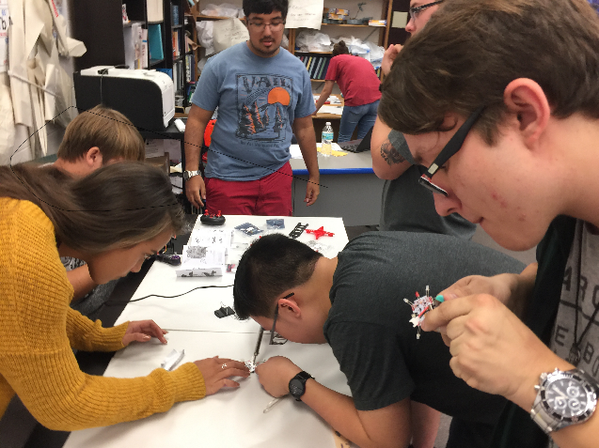
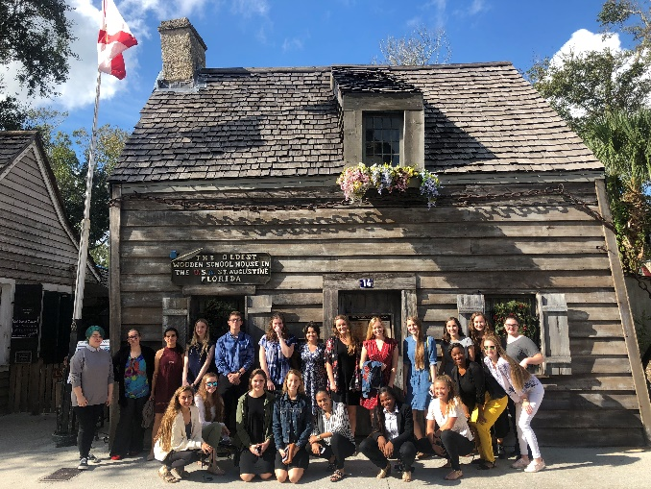

Benefits of Being in a Career Academy
Aids students in determining career path
Employable training – “Soft skills”
Industry Certifications
“School Within a School”
Summer Internships

